Slide 1

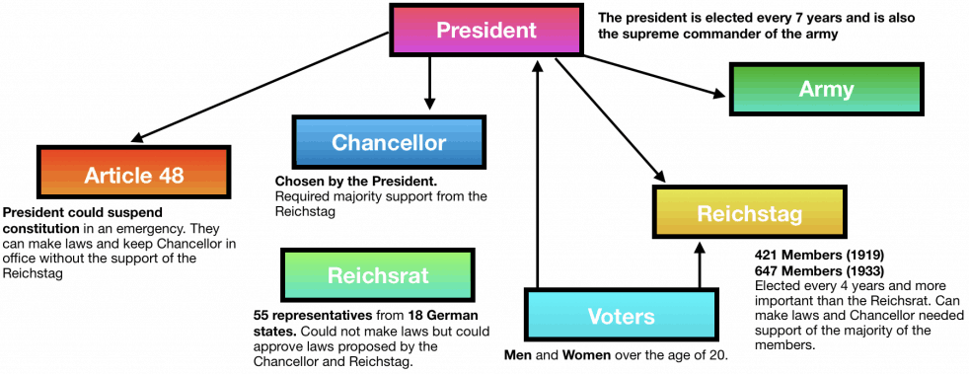





Key Words:
President – figurehead of the government.
Chancellor – head of the government on a day-to-day basis.
Reichstag and Reichsrat – the two chambers of the German Parliament.
Constitution – a set of laws that sets out how a country is governed.
Proportional Representation – a method of electing representatives where the proportion of seats a party gains in Parliament is equal to its share of the vote (ie: 10% of the vote would give that party 10% of seats in Parliament).
GCSE History Knowledge Organiser: Weimar & Nazi Germany – How strong was the Weimar Constitution?
Strengths of the Weimar Constitution | Weaknesses of the Weimar Constitution
Democratic – everyone 21+ could vote Proportional Representation is very democratic Checks & Balances meant no one person had too much power | PR led to unstable coalition government Weakness in crisis led to over-reliance on Article 48 Government had used force in order to establish it – legitimate? Unpopular with the establishment (civil service, judiciary and the army)

Slide 2





Key Dates:
11 Nov 1918 – Armistice Day
June 1919 – Treaty of Versailles signed
August 1919 – Weimar Constitution formally adopted
1923 - Hyperinflation
GCSE History Knowledge Organiser: Weimar & Nazi Germany – Why was the Weimar Republic unpopular?
The Weimar Constitution made the republic a democracy – this was unpopular with the right who preferred an authoritative leader.
Proportional Representation led to many parties represented in the Reichstag – it was therefore difficult to achieve political stability.
The Treaty of Versailles imposed severe terms on Germany including Article 231 (war guilt clause) – this was a humiliation for Germany.
Treaty of Versailles
The idea that the German civilian government sought an unnecessary surrender – stabbing the army in the back.
Criticisms of the Weimar Constitution
Why was the Weimar Republic unpopular from the beginning?
Dolchstoss
(‘Stab in the Back’)
Failure to deal with economic problems
‘November Criminals’
The legacy of WWI and then hyperinflation in 1923 were issues that successive German governments struggled to deal with – therefore angering many in Germany who suffered as a result.
The nickname given to those members of the civilian government that signed the Treaty of Versailles.

Slide 3




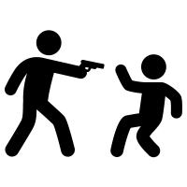
Key Words:
Polarisation – when a country divides into two sharply contrasting sets of beliefs.
Spartacists – a communist group led by Karl Liebknecht and Rosa Luxemburg.
Freikorps – a large paramilitary group made of mostly disbanded German soldiers after WWI.
Putsch – a German word for an uprising.
GCSE History Knowledge Organiser: Weimar & Nazi Germany – What challenges did the Weimar Republic face from the left-wing and right-wing between 1919 and 1923?
1919-1923: Huge political divisions in Germany between left- and right-wing groups (polarisation) – extremes of both sides unhappy with the Republic.
Challenges from left and right
Challenges from the left
Wanted Germany controlled by the people. They opposed capitalism and wanted to abolish private ownership of land business.
Challenges from the right
Wanted a return to strong government led by a powerful leader, and a strong army. Supported capitalism. Tended to be nationalist.
Spartacist Uprising (1919) – communist rising led by Luxemburg and Liebknecht defeated by the Freikorps.
Various communist risings across Germany
including Hamburg and Saxony in 1923
Attempts to establish regional socialist governments in Saxony and Thuringia
Kapp Putsch (1920) – 5,000 Freikorps soldiers occupied Berlin and invited the Kaiser to return. Weimar Government urged people not to cooperate which led to the putsch’s failure.
Munich Putsch (1923) – Hitler attempted to take over Bavarian government and then march on Berlin. Ended in failure and Hitler’s arrest and trial.
Ongoing political violence – approx. 376 murders mainly carried out by the right-wring. Two leading Weimar ministers assassinated (Erzberger and Rathenau)
Weimar Republic plagued by constant fighting and challenges to its authority. Moderate Reichstag parties struggled to form coalitions while being constantly attacked by extremist politicians.

Slide 4

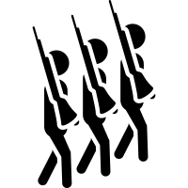
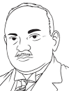





Key Words:
The Ruhr – an industrial region of Germany that generated lots of wealth.
Reparations – compensation paid by the defeated in war to the victor.
Passive resistance – a tactic employed by Germans in the Ruhr where the workers refused to cooperate with the French and employed non-violent opposition.
Hyperinflation – rapid and uncontrollable devaluation of currency leading to huge price rises.
Rentenmark – a temporary currency introduced in Germany to replace the old papiermark.
GCSE History Knowledge Organiser: Weimar & Nazi Germany – Why was 1923 a ‘crisis year’ for the Weimar Republic?
January 1923
1923
August 1923
8-9 November 1923
15 November 1923
The French Invasion of the Ruhr
Hyperinflation
Stresemann becomes Chancellor (until December) and Foreign Minister
Munich Putsch
Rentenmark Introduced
An occupation of the industrial Ruhr region by French and Belgian troops took place when Germany failed to pay reparations to those countries.
Occupation was met with passive resistance with the German workers going on strike.
To support the strikers, the government printed more money to pay them a wage.
The strike meant less goods being produced. The extra money in circulation plus the collapse in production caused hyperinflation (money lost its value).
People with savings or those on a fixed income found themselves penniless.
In November 1923,
£1 = one-thousand, six-hundred and eighty trillion marks.
1,680,800,000,000,000
In August Gustav Stresemann became both Chancellor and Foreign Minister.
His government would collapse by November but he continued on as Foreign Minister until his death in 1929, playing a big role in securing American help in Weimar’s recovery.
Hitler seized on the chaos that had taken hold of Germany in 1923 and attempted to overthrow the government in Bavaria (southern Germany).
The putsch was foiled and Hitler was arrested and tried for treason. However the trial gained Hitler publicity nationwide.
By November 1923 the value of the German mark had been destroyed.
Stresemann introduced a temporary currency – the Rentenmark – which was based on property values. This aimed to restore confidence in German currency.
After approximately a year the Rentenmark was converted into the Reichsmark, a new currency backed by gold reserves. After this, the republic began to see the signs of recovery.

Slide 5



Key Dates:
Nov 1923 – Introduction of the Rentenmark
Sept 1924 – Dawes Plan goes into effect
1924 – Reichsmark introduced as Germany’s new permanent currency
1925 – Locarno Pact
1925 – Hindenburg elected President
1926 – Germany joins the League of Nations
1927 – Allied troops withdrew from the west bank of the Rhine, five years early.
1929 – Young Plan agreed
GCSE History Knowledge Organiser: Weimar & Nazi Germany – Why did the Weimar Republic recover after 1923?
Although Stresemann was only Chancellor for a few months of 1923, in that time he introduced the Rentenmark which ended hyperinflation.
Between 1923-29, as Foreign Minister, he was instrumental in regaining Germany’s place on the world stage and helping the economy to recover
Stresemann played a role in negotiating several agreements with the USA to help recovery:
Dawes Plan (1924) – reparations would begin at 1bn marks and increase to 2.5bn marks per year over the following four years. The USA would loan 800m marks to Germany plus another $3bn by 1929.
Young Plan (1929) – reparations reduced to £1.85bn and Germany given 59 years to pay the amount – an average of 2.05bn marks per year.
Role of Gustav Stresemann as Foreign Minister
The economic recovery coupled with successes abroad led to growing political stability after 1924. Support for moderate parties grew whilst support for extremist parties dwindled. Furthermore the election of WWI hero Hindenburg as President in 1925 seemed to show the old conservative establishment now accepted the Weimar Republic.
Why did the Weimar Republic recover after 1923?
Growing Political Stability
American Assistance
Locarno Pact (1925) – agreement with Britain, France, Belgium and Italy to keep existing borders between Germany, Belgium and France. Began a period of cooperation between the European powers.
Germany joins League of Nations (1926) – Germany given a permanent seat on the Council.
Kellogg-Briand Pact (1928) – agreement with 64 other nations to use armies for self-defence only and solve all international disputes ‘by peaceful means.’
Currency Reform Ended Hyperinflation
Foreign
Policy Achievements
In November 1923 Stresemann introduced a temporary currency – the Rentenmark – which was based on property values.
After approximately a year the Rentenmark was converted into the Reichsmark, a new currency backed by gold reserves. As a result hyperinflation came to an end.

Slide 6



Key Words:
Unemployment Insurance Act (1927) – a scheme where employers and employees paid into a scheme which provided money if a person became unemployed or sick.
Neue Sachlichkeit – ‘New Objectivism’ held that the arts should show life as it really is.
Bauhaus – a movement that stressed the beauty in technology, simple lines and careful craftsmanship. Used basic shapes and colours.
Reactionary – conservative;, opposing political or social progress or reform
GCSE History Knowledge Organiser: Weimar & Nazi Germany – How far did Weimar German society change for the better?
How far did Weimar German society change for the better?
Standard of Living
Women
Culture
Evidence of improvement | Evidence of little change
Increase in real wages of over 10% by 1928 (on average) which mainly benefitted the working classes. Unemployment generally fell (only 1.3m by 1928) 2m new homes built 1924-1931 By 1928 homelessness reduced by more than 60%. The government extended the reforms introduced by Bismarck in the 1880s by introducing the Unemployment Insurance Act (1927). | Middle-classes saw little benefit – did not experience a noticeable rise in wages Unemployment still high in the professions. 184,000 unemployed middle-class workers in Apr 1928
Evidence of improvement | Evidence of little change
Weimar Constitution introduced votes for women over 20, equality in education, equal pay in the professions. By 1926 there were 32 female deputies in the Reichstag. Growing number of women in new areas of employment and public services (civil service, teaching, etc). By 1933 there were 100,000 women teachers and 3,000 women doctors. Women enjoyed more social freedom, going out unescorted, able to drink and smoke in public. | Proportion of women in work remained largely unchanged compared to pre-war levels – 36% in 1925. After WWI, the ‘better paid’ jobs were largely reclaimed by men coming back from the war. Attitudes did not change much – married women in work (‘double-earners’) often criticised for neglecting their homes.
Evidence of improvement | Evidence of little change
Strict pre-war censorship on art was removed and government provided financial support. Therefore: Weimar artists try to portray everyday life in their paintings (Neue Sachlichkeit) – Grosz and Dix. Bauhaus architecture flourished. Golden age for German cinema. Fritz land produced the film Metropolis (1926). There were discussions about war in 1920s German literature. Remarque wrote All Quiet on the Western Front (1929). Emergence of Zeittheater and Zeitoper | There were some reactionary attitudes still prevalent in Germany. Some, largely on the political right, criticised these changes and believed they seriously weakened German society and values. For these people, cultural changes only increased their opposition to the Weimar Republic.

Slide 7



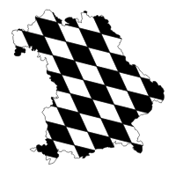

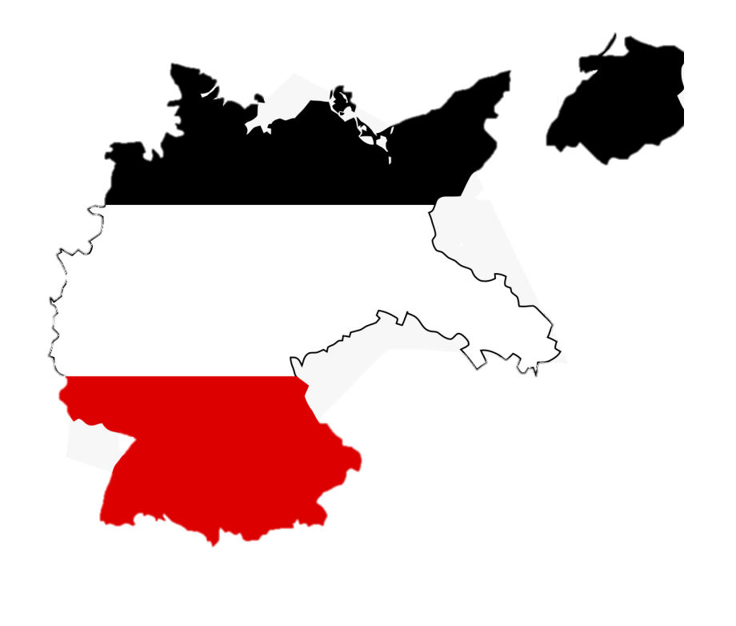




Key Words:
Nationalism – political ideas that emphasise the importance of the nation.
Socialism – political idea that all people are equal and should share in a country’s wealth.
Volkischer Beobachter – the Nazi newspaper, People’s Observer
Sturmabteiling (SA) – the Nazi’s paramilitary group made of largely ex-soldiers and students. They dressed in brown shirts.
Schutzstaffel (SS) - a paramilitary group that acted as Hitler’s bodyguard. They dressed in black uniform.
GCSE History Knowledge Organiser: Weimar & Nazi Germany – How did the Nazi Party develop under Hitler, 1919-29?
How did Hitler establish his leadership of the NSDAP by 1923?
Party Policy – Twenty-Five Point Programme
Hitler’s Personal Appeal
Party Organisation
Party
Leadership
The SA (Brownshirts)
September 1919 –
Hitler joins the German Workers’ Party (DAP)
November 1923 – Hitler leads the failed Munich Putsch
How did Hitler develop the NSDAP during the ‘Lean Years’ (1924-29)?
Hitler realised he needed a new strategy – needed to build legitimate national support
Ideas in Mein Kampf form basis of Nazi policy
Party HQ based in Munich
Hitler used his time in prison to write Mein Kampf – the book that became the inspiration of the Nazi Party
Creation of a national Nazi Party
Expansion of the SS to 3,000
Hitler’s trial earned him national publicity for his views
The Bamberg Conference (1926) shifts the NSDAP towards nationalism

Slide 8


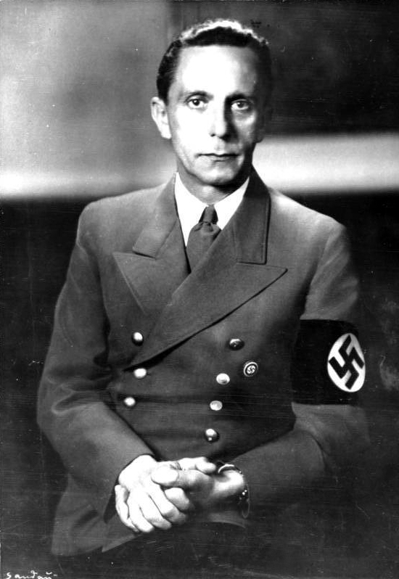

Key Words:
KPD – The German Communist Party
Industrialists – wealthy factory owners
Propaganda - information, especially of a biased or misleading nature, used to promote a political cause or point of view.
Middle-class - the social group between the upper and working classes, including professional and business people and their families.
GCSE History Knowledge Organiser: Weimar & Nazi Germany – Why did support for the Nazis grow after 1929?
German banking system collapsed. Banks recalled loans from German businesses, leading to a collapse of the German economy. This led to widespread unemployment – approx. 5m by 1932. Successive governments failed to deal with this problem.
Although Hindenburg defeated Hitler, it ensured that Hitler was recognised as a national political figure because he used modern campaigning strategies such as flying between cities to give speeches. This contributed to greater success in the Reichstag elections of July 1932.
As the government failed to deal with unemployment, German voters switched to extremist parties like the NSDAP and KPD.
The KPD had gained 1m extra voters by 1932 – this terrified the German middle- and upper-classes who feared their land and companies would be confiscated by a communist government. As support for the KPD grew among the working class, more middle-class voters switched to the Nazis because they felt Hitler was their best defence against the communists.
Impact of the Wall Street Crash
The Presidential Election of 1932
Rise in support for the KPD
Why did support for the Nazis grow after the Wall Street Crash in 1929?
Goebbels’ Propaganda
Appeal of the Nazis to different sections of society
Hitler’s personal appeal
The NSDAP’s propaganda chief, Josef Goebbels has mastered the art of propaganda, making sure that the Nazi message was everywhere, and that Hitler was seen as a the face of the NSDAP.
The Nazis had policies that appealed to particular sections of German society. This meant there was something for everyone. Support from big business in particular was key because it brought in huge amounts of money, without which Goebbels could not have conducted his nationwide propaganda campaign.
In Hitler the people saw a strong leader who promised to restore law and order, and to scrap the Treaty of Versailles. His strong skills as a public speaker helped increase membership of the party.

Slide 9





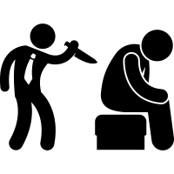
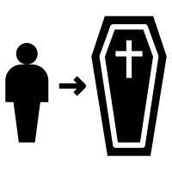

Key Words:
Dictatorship - A dictator is a political leader who possesses absolute power. A dictatorship is a state ruled by one dictator.
Constitution – the laws that set out how a country is governed.
Trade Unions – organisations that represent and defend workers’ interests.
Decree - an official order that has the force of law
Oath – a promise
Fuhrer – German word for leader.
GCSE History Knowledge Organiser: Weimar & Nazi Germany – How did Hitler establish a dictatorship, 1933-1934?
288
Feb 1933
March 1933
March 1933
May 1933
July 1933
June 1934
Aug 1934
Aug 1934
Reichstag Fire
Reichstag building burned down. A Dutch communist, van der Lubbe, caught and executed.
Hitler used the fire as an opportunity to attack the communists, having 4,000 arrested.
He then used his powers to stop the KPD taking up their 81 seats in the Reichstag.
Nazis win 288 seats in Reichstag
The Nazis increased their Reichstag members to 288. Having banned the KPD from taking up its 81 seats, and with the support of nationalist parties, Hitler now had a crucial two-thirds majority allowing him to make constitutional changes.
Enabling Act
Hitler proposed a law that would give Hitler the right to make laws for four years without the Reichstag’s consent.
Under threatening circumstances, the Enabling Act was passed by 444 votes to 94. This marked the end of democracy in Germany and the Weimar Constitution.
Trade Unions banned
Hitler believed that communists controlled the unions then they could undermine the government through strikes.
In May 1933, the Nazis arrested trade union officials, banned trade unions and made strikes illegal.
Political Parties banned
The SA destroyed the newspapers of the SPD and KPD, and confiscated their funds in May.
In July he issued a decree making all political parties, except the NSDAP, illegal.
‘Night of the Long Knives’
Hitler perceived the SA’s leader, Rohm, as a rival. Rohm leaned towards the socialists aspects of National Socialism. The SA numbered 3m men who were loyal to Rohm, putting him in a position to challenge Hitler.
In June 1934, Rohm and leading members of the SA were arrested and shot. The SA was now firmly under Hitler’s control.
Death of Hindenburg – Hitler becomes Fuhrer
President Hindenburg died in August 1934. Soon after, Hitler combined the offices of Chancellor and President, making himself Fuhrer.
Hitler was now without rival as the leader of Germany.
Army Oath
The Night of the Long Knives had already eased some fears the army had about the SA and meant they would now support Hitler.
Upon Hindenburg’s death, Hitler had the army swear an oath of allegiance to him personally.
By the end of 1934, Hitler was in a very secure position because of his new title, the support of the army and the removal of opposition.

Slide 10


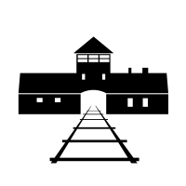


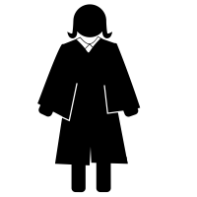
















Key Words:
Propaganda - information, especially of a biased or misleading nature, used to promote a political cause or point of view.
Judiciary – the legal system: judges and courts.
Concordat – an agreement between the Nazi regime and the Pope that the Catholic Church would not interfere in German politics in return for religious freedom for Catholics in Germany. Hitler soon broke this agreement.
Gestapo – plain-clothed secret police led by Heydrich from 1936.
Concentration camps – large prisons for political prisoners
GCSE History Knowledge Organiser: Weimar & Nazi Germany – How did the Nazis control attitudes in the Third Reich?
The SS
The SD
The Gestapo
Sent people to
Concentration camps
Newspapers
The Nazi
Police State
Radio
Judges had to be member of the National Socialist League for the Maintenance of the Law.
Posters
Goebbels's Ministry of Propaganda
How did the Nazis control attitudes in the Third Reich?
Control of the Judiciary
Abolition of trial by jury and founding of the People’s Court
Literature
Rallies
Nazi Policies Towards the Church
Nazi Control of the Arts and Sport
Catholic Church
Protestant Church
Sport encouraged.
Berlin Olympics (1936) was a major showcase event.
Art should stress romantic ideas about Germany’s past
‘Monumental style’ of buildings encouraged
Jazz banned, German folk music and music by German composers promoted.
Concordat (1933)
Catholic youth activities banned
Formation of the Reich Church (1936)

Slide 11


Key Words:
Opposition – resistance or dissent to something.
High Command – the senior staff of the army.
Hitler Youth – the Nazi youth organisation for boys 14-18. Membership was compulsory from 1936.
The League of German Maidens – the Nazi youth organisation for girls 14-18.
Pastors’ Emergency League – a group of Protestant pastors led by Martin Niemoller who opposed the treatment of Protestant churches in Germany.
GCSE History Knowledge Organiser: Weimar & Nazi Germany – How effective was opposition to the Nazi regime between 1933-1939?
How effective was opposition to the Nazi regime between 1933-1939?
The Army
The Youth
The Church
Evidence of opposition | Evidence of conformity
Chief of German High Command, Ludwig Beck, resigned in protest at Hitler’s plans. | Plan to overthrow Hitler in 1938 abandoned after his successes in Czechoslovakia.
Evidence of opposition | Evidence of conformity
Edelweiss Pirates – copied American fashion trends and taunted Hitler Youth members. The Swing Youth – admired American culture and music. They organised illegal dances. | Membership of the Hitler Youth by 1939 was around 8m. Many young people were enthusiastic and committed Hitler Youth members.
Evidence of opposition | Evidence of conformity
Pastors’ Emergency League (1933) and Confessional Church (1934) set up in opposition to the Reich Church Pope’s message, With Burning Concern, read in all Catholic Churches in 1937 | Pope Pius XI and Hitler agreed the Concordat in 1933 Many Protestants joined the Reich Church Attendance of non-Reich Church services did not become open opposition
There was some opposition to the Hitler and Nazi regime but it was never coordinated or unified. The young, the Church and the army did present some challenges to Hitler but they were never enough to threaten the regime in the years 1933 to 1939.

Slide 12
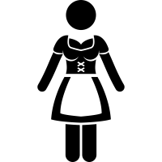





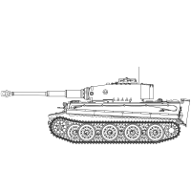
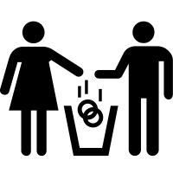






Key Terms:
Curriculum – what is taught in schools.
Law for the Encouragement of Marriage (1933) – gave loans to help young couples marry.
Mothers’ Cross – a medal given to women who had a certain number of children.
Lebensborn – a programme where unmarried women could become pregnant by ‘racially pure’ SS men.
Rearmament – when a country begins to rebuild its armed forces.
Invisible Unemployment – using dubious methods to keep unemployment figures low.
GCSE History Knowledge Organiser: Weimar & Nazi Germany – How did life in Germany change under the Nazis by 1939?
How did life in Germany change under the Nazis by 1939?
Young People
Women
Employment and Living Standards
Bring up the young as proud Germans, make them strong and healthy, teach them to support Nazi ideas. Boys should learn to do productive work for the German economy and fight in the armed forces. Girls should learn how to be good wives and mothers.
Women should adopt a traditional role and stay at home rather than go to work. They should adopt a ‘natural’ look with simple plaited hair and long skirts. The Nazis wanted women to marry and have many children to make Germany bigger and stronger.
To reduce unemployment through providing work for the unemployed and expanding public works.
Nazi policies towards unemployment
National Labour Service (RAD)
Nazi policies towards the young
Nazi policies towards women
Hitler Youth (political, physical and military training)
Law for the Encouragement
of Marriage (1933)
Autobahns (motorways)
Rearmament
League of German Maidens (preparation for marriage and motherhood)
Change in divorce laws
(1938)
The Mother’s Cross
Nazi policies towards living standards
Nazi Teachers’ League
Strength Through Joy (KdF) & Beauty of Labour
Lebensborn (1935)
Nazification of the curriculum
Volkswagen Scheme
Reduction of women in work
Although many young people joined the Nazi organisations, it was not always popular with its members.
As German industry grew alongside rearmament, the needs of the state brought more women back into work.
Not all workers benefitted from Nazi policy. Unemployment figures are dubious due to ‘invisible employment.’

Slide 13






Key Words:
Civil Service – government employees.
Boycott – refusing to buy or take part in something as a protest.
Segregation – keeping two groups apart.
Synagogue – the Jewish place of worship.
Forced emigration – forcing or strongly pushing people to leave a country.
The ‘Final Solution’ – the plan by the Nazis to exterminate Europe’s Jewish population using death camps and gas chambers.
GCSE History Knowledge Organiser: Weimar & Nazi Germany – How did persecution of the Jewish people escalate?
Apr-May 1933
Apr 1933
1934
Sept 1935
1938
9-10
Nov 1938
Apr 1939
1942-1945
Jews banned from certain jobs
Jews could no longer work in the civil service or teaching.
Jews were banned from the army.
Boycott of Jewish businesses
For one day (1st Apr) Germans were encouraged to boycott Jewish businesses.
The SA stood as an intimidating presence at the entrance to business premises.
Growth of segregation
Local councils controlled by the Nazis began to ban Jews from parks and swimming pools. Others provided separate park benches for Jews.
Nuremberg Laws
The Reich Law on Citizenship stripped Jews of their citizenship and required them to wear a yellow Star of David on their clothes.
The Reich Law for the Protection of German Blood and Honour forbade marriage and sexual relations between Germans and Jews.
Escalation of measures
Jews had to register all of their possessions and carry identify cards.
Kristallnacht
In response to the murder of a German official by a Jew, the Nazis organised an anti-Jewish demonstration involving attacks on Jewish property, shops, homes and synagogues.
100 Jews were killed, 7500 businesses and 191 synagogues destroyed.
Formation of the Reich Office for Jewish Emigration
The SS became responsible for driving the Jews out of Germany through forced emigration.
However the outbreak of World War II forced the Nazis to change their plans.
The Final Solution
German conquests during WWII brought millions more Jews under Nazi control which led to the ‘Final Solution’ (the use of death camps) from 1942 onwards.
Which minorities were persecuted by the Nazi regime?
Jews | Roma | Slavs | Homosexuals | The Disabled | Afro-Germans

