Slide 1
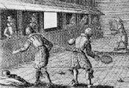
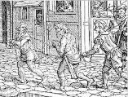
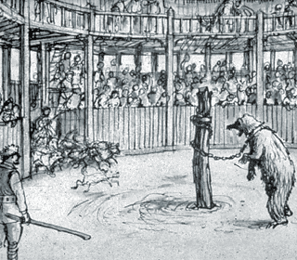
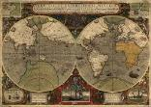
Edexcel GCSE 9-1 History
Early Elizabethan England 1558-88
Key Topic 3
Elizabethan Society in the Age of Exploration 1558-88
Name:
Edexcel GCSE History Early Elizabethan England, 1558-1588 – PLC |  |  | Page | Lesson | Revised
Section 3: Elizabethan society in the Age of Exploration, 1558-88 | Key Topic 3.1 Education and leisure | A. Education in the home, schools and universities. | 7-17
 |  | B. Sport, pastimes and the theatre. | 18-24
 | Key Topic 3.2 The problem of the poor | A. The reasons for the increase in poverty and vagabondage during these years. | 25-32
 |  | B. The changing attitudes and policies towards the poor. | 33-34
 | Key Topic 3.3 Exploration and voyages of discovery | A. Factors prompting exploration, including the impact of new technology on ships and sailing and the drive to expand trade. | 35-40
 |  | B. The reasons for and significance of Drake’s circumnavigation of the globe | 41-46
 | Key Topic 3.4 Raleigh and Virginia | A. The significance of Raleigh and the attempted colonisation of Virginia. | 47-54
 |  | B. Reasons for the failure of Virginia. | 55-59
Notes:
21.0 x 29.7 cm

Slide 2
Keywords
1. apprentice | Someone learning a trade or a skill. In Elizabethan times, apprentices were not paid. In fact, it cost money to be a apprentice. Once qualified, skilled craftsmen usually enjoyed a very good standard of living.
2. cartographer | A person who draws or produces maps.
3. circumnavigate | Sail or travel all the way around the world.
4. colonies | Lands under the control or influence of another country, occupied by settlers from that country.
5. Corporal punishment | A physical punishment such as flogging and whipping.
6. customs duties | Taxes made from trade.
7. debt | A sum of money that is owed or due.
8. Elizabethan Education | Education became increasingly valuable in Elizabethan England. The education you might receive was aimed at preparing you for the life you were expected to lead. This meant it usually focused on practical skills but could include basic literacy.
9. Elizabethan Leisure | In Elizabethan England, your social class and gender could determine what sports and leisure activities you could participate in. For the nobility, there was hunting on horseback, hawking fishing and fencing and for the working people there was spectator sports, bear baiting and cock fighting.
10. embargo | an official ban on trade or other commercial activity with a particular country.
11. enclosures | Relating to Elizabeth's changes to the countryside. Enclosing land meant replacing large, open fields that were farmed by villagers with individual fields belonging to one person.
12. Extraordinary taxation | Occasional, additional taxation to pay for unexpected expenses, especially war. Could only be approved by Parliament.
13. Globe Theatre | Shakespeare's theatre.
14. Hanged, drawn and quartered | A type of punishment used when the accused was found guilty of high treason/ The accused would be hanged until near dead, cut open, have their intestines removed, and were finally chopped into four pieces.
15. Idle Poor / Deserving Poor | Able bodied or idle poor - those who were fit to work but didn’t. Deserving/Impotent poor - those who were unable to work due to age or illness.
16. inflation | A general increase in prices and fall in the purchasing value of money.
17. itinerants | A person who travels from place to place i.e. - the deserving poor who lost their homes and jobs due to the enclosures act.
18. Manteo and Wanchese | Native American Indians who were brought back to England in 1584. Thomas Harriot, a mathematician, learned their language and taught them English.
19. merchants | A person or company involved in wholesale trade, especially one dealing with foreign countries or supplying goods to a particular trade.

Slide 3
Keywords
20. Native Americans | A member of any of the indigenous peoples of North and South American and the Caribbean Islands.
21. Nova Albion | Discovered in 1579 by Sir Francis Drake in what was probably north of modern day San Francisco.
22. patronage | Receiving encouragement or financial support for an individual cause. For example, Elizabeth I gave patronage to many explorers and certain noble families she could trust.
23. Petty schools | Schools set up and run in a teacher’s home. Boys whose parents could afford to send them to school began their education here.
24. Poor Relief Act, 1576 | Aim was to distinguish between able bodied and impotent poor, and to help the able bodied poor find work.
25. population growth | England's population grew by 35% during Elizabeth's reign. Population in towns and cities grew especially fast. Because there were more people to feed, the price of food in towns rose as the food was grown in the countryside.
26. privateer | Historically, individuals (usually merchants or explorers) with their own armed ships that capture other ships for their cargoes, often with the authorisation or support of their government (basically pirates).
27. quadrant/ astrolabe | Quadrant - Similar to an astrolabe, it was used by sailors to help with navigation at sea. It was the shape of a quarter circle. Astrolabe - An instrument used by sailors to help with navigation at sea. it was circular.
28. rural depopulation | When the population of the countryside falls as people move away in search of a better life.
29. sheep farming | English wool and woollen cloth accounted for 81.6% of England’s exports during Elizabeth’s reign. Demand went up and therefore so did the price. However, the increase in sheep farming was blamed for the problems in farming because sheep farming took land that was for crops and common land. Furthermore, sheep don't require as much labour and the food going to sheep in the winter could have been used for the hungry people.
30. social mobility | Being able to change your position in society.
31. Statue of the Artificers, 1563 | First government action aimed at the poor. The aim of the statute was to ensure that poor relief was collected. The key features include: anyone who refused to pay the poor rates could be imprisoned, officials failing to organise poor relief could be fined up to £20.
32. subsistence farming | Growing just enough to feed the family but not to sell.
33. Tenant farmers | Farmed rented land usually owned by yeomen or gentry.
34. Trade embargo | When governments ban trade with another country.
35. triangular trade | Trade between England West, Africa and America carrying slaves, cash crops and manufactured goods.
36. Vagabonds Act, 1572 | Aim to deter vagrancy. The act stated that vagrants were to be whipped and hole drilled through each ear. Vagrants were also imprisoned if arrested a second time for vagrancy, and given the death penalty for the third.
37. vagrants | Homeless that travelled looking for work
38. Virginia | Attempt to colonise Virginia in America. This was significant for the following reason: it would undermine Spain, economic benefits and it was the roots of the British Empire. However the colonisation failed for the following reasons: The voyage (a breach in the ship ruined all the food), Colonists: Expectations and reality, Inexperience of the colonists and Native American resistance.

Slide 4
Key Topic 3.1: Education and Leisure
A. Education in the home, schools and universities.
TASK: Answer the following recap questions from key topic 2.
1. When was the Revolt of the Northern Earls and who led it?
2. Give two reasons for the outbreak of war between England and Spain in 1585.
3. What happened in Cadiz in 1587?
4. When was Mary, Queen of Scots executed?
5. What was important about the 1570 Papal Bull of Excommunication?
6. Who commanded the Spanish Armada and the English fleet sent against it?
7. Who began arriving in England in 1574?
8. Give two examples to show how worried Parliament was or Elizabeth’s safety.
9. What happened at Gravelines in 1588?
10. Explain what the Throckmorton Plot of 1583 was and why it failed.
11. List three ways in which Walsingham’s ‘secret service’ protected Elizabeth.
12. List three reasons for the defeat of the Spanish Armada in 1588.

Slide 5
Key Topic 3 – Elizabethan Society and the Age of Exploration
A Golden Age?
The Elizabethan Era took place from 1558 to 1603 and is considered by many historians to be the golden age in English History. During this era, England experienced peace and prosperity while the arts flourished. The Elizabethan Era is perhaps most famous for its theatre and the works of William Shakespeare, though, his plays fall out of the timeframe of our course so you won’t be able to mention him in an exam question.
TASK: Highlight evidence of the fact the Elizabethan age was a Golden Age, and evidence it was not.
Life for the wealthy became increasingly luxurious and flamboyant. Rich lords built huge mansions in the countryside. One famous Tudor mansion is Hampton Court. The lord would have a parlour, luxuriously panelled, with painted ceilings and tapestries hanging on the wall, and with high-sided dark wooden chairs. | There was no welfare state in Tudor and Stuart England. If you lost your job or grew too ill or old to work you had three options: beg, steal or die. There were some attempts to improve life for the poor, but these didn’t always make much difference. In the towns, one in five people were living in extreme poverty. | Even though there was an unmarried woman on the throne in Elizabethan England, the roles of women in society were very limited. The Elizabethans had very clear expectations of men and women, and in general men were expected to be the breadwinners and women to be housewives and mothers.
A public execution was an event not to be missed and people would queue through the night to get the best places. There was always a carnival atmosphere and pie sellers, ale merchants and producers of execution memorabilia did a good trade. Public executions always produced a carnival-like atmosphere with large crowds attracting peddlers, minstrels and other street performers. | The popularity of the theatre rose with both rich and poor alike, during the sixteenth century. This popularity helped by the rise of great playwrights such as Christopher Marlowe and William Shakespeare as well as the building of the Globe theatre in London. The popularity of the theatre reached people from all walks of life- from Royalty to the Nobility and the Commoners. | In 1570, Sir Thomas Gresham opened the Royal Exchange. After Queen Elizabeth I visited it, it became a fashionable shopping mall. Queen Elizabeth I who awarded the building its royal title and a licence to sell alcohol Fashions in Tudor times consisted of men wearing decorated doublets (jackets) with peasecod bellies (rounded front) and slashed trunks (short trousers with cuts in fabric). Women wore fancy kirtles (overskirts) over wooden frames called farthingales, with high collars.
Before the Reformation it had always been considered Christian duty to carry out the instructions laid down in Matthew chapter 25 – that all Christians should help feed the hungry and look after the poor. After the Reformation, many of these values disappeared and the poor were left without help. | Arts such as music and painting were also popular during the time. The era produced important composers such as William Bryrd and John Dowland. England also began to produce some of its own talented painters such as Nicholas Hilliard and Queen Elizabeth’s personal artist George Gower. | Sports were very popular in the Sixteenth Century. Some of the most popular are still played today: Jousting, pitching the Bar, throwing the sledgehammer, leaping, shin kicking (with iron-tipped boots), sword fighting, performing headstands, and fox hunting.

Slide 6
Key Topic 3 – Elizabethan Society and the Age of Exploration
A Golden Age?
TASK: Answer the following questions.
Which piece of evidence do you think is the best example of showing that Elizabethan England was a golden era? Explain why you chose this piece of evidence.
____________________________________________________________________________________________________________________________________________________________________________________________________________________________________________________________________________________________________________________________________________________________________________________________________________________________________________________________________________________________________________________________
Which piece of evidence do you think is best example of showing that it wasn’t a Golden era? Explain why you chose this piece of evidence.
____________________________________________________________________________________________________________________________________________________________________________________________________________________________________________________________________________________________________________________________________________________________________________________________________________________________________________________________________________________________________________________________
Overall, do you think historians are right in calling this period a Golden Era? Why?
________________________________________________________________________________________________________________________________________________________________________________________________________________________________________________________________________________________________________________________________________________________________________________________________________________________________________________________________________________________________________________________________________________________________________________________________________________________________________________________________________________________________________________________________________________________________________________________________________________________________________________________________________________________________________________________________________________________________________________________________________________________________________________________

Slide 7
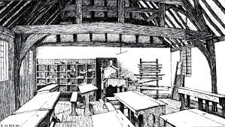
Key Topic 3.1: Education and Leisure
A. Education in the home, schools and universities.
Education
Attitudes to education
Education was becoming increasingly valuable in Elizabethan England despite the fact there was no national system of schooling. Although attitudes to education started to change during Elizabethan period, they still reflected the social hierarchy of the country. Education was not about social mobility (being able to change your position in society) nor was it about nurturing talent and ambition. This was because the social order was extremely important to Elizabethans and any education you might receive was aimed at preparing you for the life you were expected to lead. Therefore, education was usually focused on practical skills, but could include basic literacy. Very few girls received any formal education whilst only a small per centage of children altogether, mainly boys, received any kind of formal education.
New influences on education
Humanists, who were thinkers and writes in the 16th century, believed that learning was important in its own right. They believed that people shouldn’t be educated for practical reasons. They wanted to develop a better understanding of the world so they studied the work of ancient philosophers and mathematicians to develop a better understanding of the world.
On top of this, protestants believed that people should e able to read the Bible in their own language, this was so they people could develop their own personal relationship with God. This encouraged more people to become literate. As trade increase and business increased in England, a basic education became more important to more people, especially in towns and cities.
Nethertheless, it is important not to exaggerate or hyperbolise the significance of the change in education during the Elizabethan period. For most people, education was limited according to their place in the social hierarchy, and in rural areas, where farming remained a way of life, little had changed.
TASK: Because, But and so. Look at the sentence stem below, turn each one into a complex sentence based on what you have just read.
Education during the Elizabethan period changed because ______________________________________________________________
________________________________________________________________________________________________________________________________
Education during the Elizabethan period changed, but ___________________________________________________________________
________________________________________________________________________________________________________________________________
Education during the Elizabethan period changed, so ____________________________________________________________________
________________________________________________________________________________________________

Slide 8
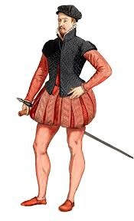
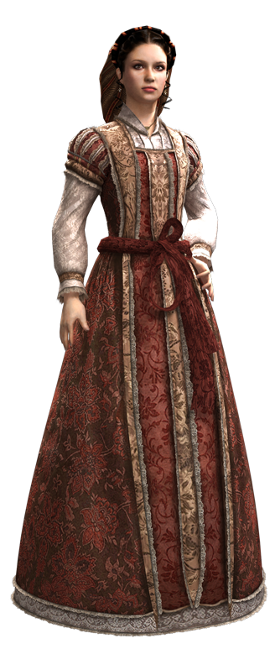
Key Topic 3.1: Education and Leisure
A. Education in the home, schools and universities.
TASK: Complete the sentence on the right hand side showing the change in attitudes towards education.
Traditional Aims of Education
Humanists Aims of Education
To teach the richest how to read, write in English and Latin. Very religious.
Believed education was important for… ___________________________________________________________________________________________________________________________________________________________________________
To maintain the existing social order (poor learn practical skills)
Protestants believed the bible should… ___________________________________________________________________________________________________________________________________________________________________________
More trade and business meant… ___________________________________________________________________________________________________________________________________________________________________________
Only a small percentage went to school – mainly boys.
Education in the home
Nobility
The children of the nobility learned a variety of subjects such as foreign languages, including Latin and Greek, History, Philosophy, Government and Theology. Elizabeth was highly educated in these subjects and as a result, many of the noble families made sure that their daughters were too. Along with these subjects, upper class women were taught a range of skills that were expected of the upper class like needlework, horse riding, archery, music and dancing. They were tutored at home, along with their brothers (though separately), till the age of around seven. Boys were also taught horse riding and archery too along with other sports that were fitting only for men such as swimming, fencing and wrestling.
Children of noble families were often sent to another noble household to finish their education. In the Elizabethan period, the eldest son would inherit their families titles and therefore had to learn how to become a future nobleman. Girls that went to another noble family for education would make important social contacts, as well as perfect those skills expected of them as a noble woman.

Slide 9
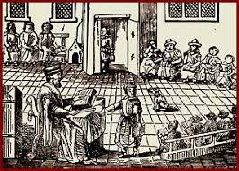
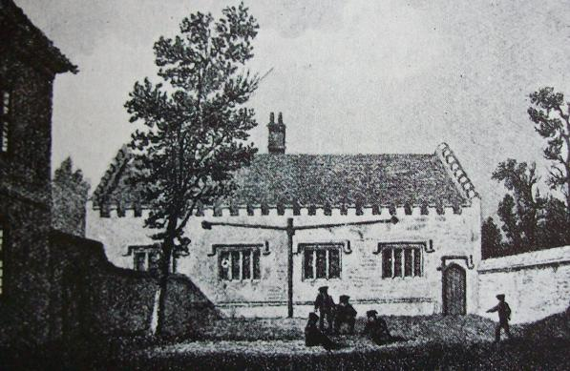
Key Topic 3.1: Education and Leisure
A. Education in the home, schools and universities.
Middling sorts and grammar schools
The greatest change in education in Elizabethan England was the development of grammar schools: 42 were founded in 1560s, and 30 more in the 1570s. As a result, there were more schools in Elizabethan England than there had ever been before. Previously, the Church provided most of the minimal education available to children.
Grammar schools were slightly different in Elizabethan times than they are nowadays. They were private schools set up for boys considered bright, who mainly came from well-off families in towns – the sons of middling sorts: the gentry, professionals or wealthy business owners. Girls could not attend grammar schools. They were usually educated at home by their mothers, preparing them for married life and running a household.
In terms of fees, grammar schools charged a varied amount depending on how much property the boy’s family owned. Some lower class boys were able to attend for free if they showed promise. They were funded by people who left money to the schools in their wills who had the intention of providing education to those who could not afford it.
The school year was long, with holidays only at Christmas and Easter. The day lasted almost ten hours, usually beginning at 6 am or 7 am. The focus of the curriculum was Latin. The boys also studied ancient, classical historians and philosophers and writers such as Plato, Aristotle, Virgil and Seneca. There would also be time allocated to sports and activities like archery, chess, wrestling and running.
There was a great emphasis on memorising huge quantities of texts, especially Bible passages, many of which focused on teaching morals and manners. On top of this, debating was also an important subject. Two or three boys would be expected to debate a topic set by the teacher. Debating and public speaking was thought essential for a well-educated Elizabethan gentleman.
As well as school Monday through to Friday, there was also school on a Saturday morning. There would often be more recitation of the week’s lessons but also other activities.

Slide 10
Key Topic 3.1: Education and Leisure
A. Education in the home, schools and universities.
TASK: Use the fragments below to write 6 sentences explain what you have read about education at home, the middling sort and grammar schools. You can use the fragment at the start, middle or end of your sentence. UNDERLINE each fragment when you have included it.
…needlework, horse riding and archery… | … another household… | …the greatest change…
…fees varied… | …Plato and Aristotle… | …memorising text…
____________________________________________________________________________________________________________________________________________________________________________________________________________________________________________________________________________________________________________________________________________________________________________________
____________________________________________________________________________________________________________________________________________________________________________________________________________________________________________________________________________________________________________________________________________________________________________________
____________________________________________________________________________________________________________________________________________________________________________________________________________________________________________________________________________________________________________________________________________________________________________________
____________________________________________________________________________________________________________________________________________________________________________________________________________________________________________________________________________________________________________________________________________________________________________________
____________________________________________________________________________________________________________________________________________________________________________________________________________________________________________________________________________________________________________________________________________________________________________________
____________________________________________________________________________________________________________________________________________________________________________________________________________________________________________________________________________________________________________________________________________________________________________________
TASK: True or false. Below are a list of statements, you need to decide if they are true or false. If they are false, you need to write the correction at the end column.
Statement | True | False | Correction
1. Children of the nobility would learn foreign languages like Latin and French.

Slide 11




Key Topic 3.1: Education and Leisure
A. Education in the home, schools and universities.
Statement | True | False | Correction
2. Upper class woman were taught skills expected of an upper class woman.
3. The youngest son inherited his fathers titles so had to learn how to be a nobleman.
4. 42 grammar schools were founded in 1570s.
5. Grammar school fees varied but some lower class were able to attend for free.
6. Debating was an essential part of being a well educated person.
7. School was Monday to Friday but they also had school on Sunday mornings.
HOT: How do these images relate to what you have just read? Be specific with the explanation.
HOT: Create your own symbol that represents what you have just read:

Slide 12
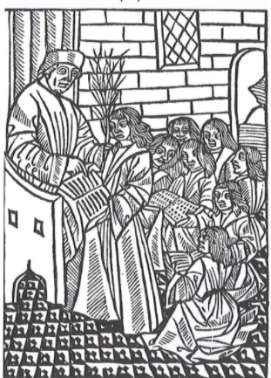
Key Topic 3.1: Education and Leisure
A. Education in the home, schools and universities.
TASK: Look at the picture below and complete the table underneath using the sentence stems. This does not need to be in full sentences.
A 16th century woodcut showing a teacher and his pupils.
Who/what?
When?
Why?
Where?
TASK: Expand your sentences from the table above to write expanded sentence. Make sure you start of with the ‘when’ stem.
_________________________________________________________________________________________________________________________________________________________________________________________________________________________________________________________________________________________________________________________________________________________________________________________________________________________________________________________________________________________________________________________________________________________________________________________________________________________________________________

Slide 13
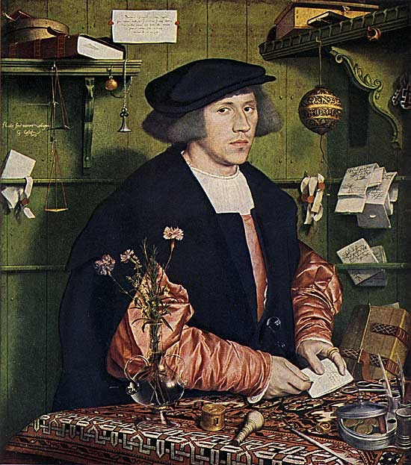
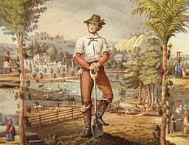
Key Topic 3.1: Education and Leisure
A. Education in the home, schools and universities.
Discipline and punishments
Inside the classroom, the teacher maintained the discipline but outside, two boys were made monitors and had to report misbehaviour inside and outside school grounds, including the street. Some of the punishments in Elizabethan grammar schools were similar to what there are today including being kept in at break time, exclusion from school and being ‘on report’. However, they did have Corporal punishment, including the cane, similar to what your parents would have experienced.
Merchants and Craftsmen
There were some alternative curriculums available for the sons of merchants and craftsmen in some grammar schools. These focused on more practical academic subjects like English, Writing, Arithmetic and Geography. This shows education reflecting what the economy needed, but still focused on preparing boys for the life they were expected to lead.
Skilled craftsmen and yeoman
Though there were grammar schools available, most of the children of craftsmen and yeomen farmers came from apprenticeships, where they would learn what was necessary to run the family business or farm.
For boys whether children could go to school or not often depended on whether
their family could manage without having them help in the family business in the home. School was not compulsory in the Elizabethan times, meaning that children didn’t have to go, a child’s education depended on whether their parents valued a school-based education. Even then, some children would have to leave school at an early age to go to work or to become an apprentice to a master craftsman.
Petty Schools
Petty schools were often set up and run in a teachers homes. For those who could afford it, a boys education would be here, if you had a daughter, they would start in a Dame School. Punishment was harsh and children would often be beaten for poor behaviour or not doing well in lessons. Children would be taught Reading and Writing in English, as well as basic Arithmetic.
Schools for Girls
Girls of all classes did not often go to school. For those that did however, they would attend a Dame School. These provided a basic education for girls and they were run by a local educated woman. This is where they get their name from.
Keyword
Apprentice: Someone learning a trade or a skill. In Elizabethan times, apprentices were not paid. In fact, it cost money to be an apprentice. Once qualified, skilled craftsmen usually enjoyed a very good standard of living.

Slide 14
Key Topic 3.1: Education and Leisure
A. Education in the home, schools and universities.
Women were not expected to go out into the world, but would go from being under their father’s care to their husband’s. They were not expected to support themselves. For most girls, education was focused on the home. As wives and mothers, they would need a wide variety of skills. For example, it was important to know how to preserve food, bake, brew, sew and treat simple aliments and injuries.
Labourers and poor children
As the majority of the population were farmers or labourers, the majority of children didn’t receive any school-based education. They learned what they needed from their families, working on the land or in the home. As a result, the jobs they could expect to find did not require literacy or numeracy.
To everyone in Elizabethan society, the education or training you received would fit you for the life you were excepted to lead, depending upon your place in the social order.
How big an impact did schools have on Elizabethans?
It is estimated that around 30% of men and 10% of women were literate (could read and write) by the end of Elizabeth's reign in 1603, compared with 20% of men and 10% of women in 1530s. These statistics suggest that there was an improvement in education for boys but not for girls during the Elizabethan times. The main obstacle to schooling was its cost. There weren’t only fees to consider, but the loss of family income from children not working.
This might explain ordinary people’s attitudes to educating their daughters does not seem to have changed in Elizabethan times. Girls were expected to marry, not to work outside the home Boys were expected to find paid employment and support their wives and children. A little education could help them find a better Job.
Education in universities
For those who were able to go on to higher education, Elizabethan England and two universities: Oxford and Cambridge. You would start university at the age of 14, unlike today and the curriculum included Music, Astronomy, Philosophy, Medicine, and Law. The highest university qualification was the doctorate. Doctorates could be taken in Medicine, Law or Divinity.
Oxford and Cambridge universities are made up of different colleges, many of which were founded by the Tudors. In 1571, Elizabeth I founded Jesus College in oxford to educate Welsh boys. One of Elizabeth’s Privy Councillors, Sir Walter Mildmay, founded Emmanuel College in Cambridge in 1584. Both Elizabeth and Mildmay wanted their colleges to educate more Protestant clergymen, so to increase the number of well-educated, Protestant clergymen.
In London, the Inns of Court trained lawyers. Some young men went to study and practise law at the Inns of Court, rather than Oxford or Cambridge, for their higher education.

Slide 15
Key Topic 3.1: Education and Leisure
A. Education in the home, schools and universities.
Lower class boys and girls had no formal education.
Middle class boys
Petty Schools 4-5 until 7-9
Grammar Schools 4-5 until 7-9
University Apprenticeship
Middle class girls
Dame School
Noble boys
Private Tutor until early teens
Noble household until mid teens
University
Noble girls
Private Tutor until early teens
Noble household until mid teens
TASK: Complete the table showing the different education available to Elizabethans. Include what they leaned, where and how long they would be in education for.
 | Boys | Girls
Upper Class
Well-off Children
Poor Children

Slide 16
Key Topic 3.1: Education and Leisure
A. Education in the home, schools and universities.
TASK: ‘The opportunities for better education increased during Elizabeth’s reign’. Using what you have just read, write a paragraph explaining whether you agree or disagree with the statement.
HOT: How did Protestantism encourage more education? Answer this question within your paragraph.
________________________________________________________________________________________________________________________________________________________________________________________________________________________________________________________________________________________________________________________________________________________________________________________________________________________________________________________________________________________________________________________________________________________________________________________________________________________________________________________________________________________________________________________________________________________________________________________________________________________________________________________________________________________________________________________________________________________________________________________________________________________________________________________________________________________________________________________________________________________________________________________________________________________________________________________________________________________________________________________________
________________________________________________________________________________________________________________________________
TASK: The cards below give evidence that either agree or disagree with the statement ‘The opportunities for better education increased during Elizabeth’s reign’. Colour code the cards to show if they agree or disagree.
Agree Disagree
A. Most people were still too poor to send their children to school. By the end of Elizabeth’s reign. Though the majority of the gentry and yeomen were literate. | B. Educational opportunities increased for all classes and ages, but it was mainly boys from well-off families who benefited the most. The upper classes increasingly saw a university education as necessary for a career in court.
C. A countryman, speaking in the early seventeenth century said: This is all we go to school for: to read common prayers at church and set down common prices at markets, write a letter and make a bond, set down the day of our births, our marriage day and make our wills when we are sick for the disposing of our goods when we are dead. | D. Education was mainly for well-off boys, but bright boys from the lower classes could go to grammar school, and even university if they had some financial support. Hardly any schooling was free – even schools for the lower classes often charged for coal, candles and educational materials. However, approximately one-third of students who graduated from both Oxford and Cambridge came from the nobility and gentry, with the reminder coming from the lower classes.
E. The earliest independent or public schools were Winchester and Eton. These fee-paying boarding schools were set up for ‘ruling-class boys’. All lessons were taught in Latin and the curriculum combined the methods of the grammar schools with an emphasis on the conduct, courtesy and etiquette (manners) necessary to produce gentlemen detained for careers at court. | F. Parish/Petty schools were local schools where young children, from about ages four to seven, were taught to read and write as preparation for moving onto a grammar school. It was nearly always boys who attended, although there were a small number of girls from the upper classes. These schools could be attached to a grammar school, in which case the small boys would be taught by older pupils, or attached toa village church, or might even be in a local woman’s house, the so-called dame schools.

Slide 17
Key Topic 3.1: Education and Leisure
A. Education in the home, schools and universities.
G. Sons of the nobility were first educated at home by a private tutor. At age fifteen, they would go to university, although some might first attend one of the new public schools. Daughters would also be educated at home. Most wealthy and titled women were able to read and write, and some, like Elizabeth herself, received an exceptional education at home, from their tutors. | H. Some of the lower classes were taught to read and write by their masters at their place of work, and in the case of servants and apprentices, this would probably be where they lived as well.
I. Sons of gentry, merchants and yeomen would most likely go to grammar schools, from the ages of 7-15, although a small number might attend on of the new public schools. During Elizabeth’s reign, 72 new grammar schools were founded. Demand for places increased throughout the reign, from all social classes. The subjects taught were mainly Latin and Greek, as this study of the classics was thought to encourage intellectual personal and spiritual growth.
TASK: ‘The opportunities for better education increased during Elizabeth’s reign. Revisit your paragraph to this question. Has your opinion changed or has it stayed the same? Explain below using specific detail.
________________________________________________________________________________________________________________________________________________________________________________________________________________________________________________________________________________________________________________________________________________________________________________________________________________________________________________________________________________________________________________________________________________________________________________________________________________________________________________________________________________________________________________________________________________________________________________________________________________________________________________________________________________________________________________________________________________________________________________________________________________________________________________________________________________________________________________________________________________________________________________________________________________________________________________________________________________________________________________________________
________________________________________________________________________________________________________________________________
HOT: Describe two features of: Grammar schools
Feature 1
________________________________________________________________________________________________________________________________________________________________________________________________________________________________________________________________________________________________________________________________________________________________________________________________
Feature 2
________________________________________________________________________________________________________________________________________________________________________________________________________________________________________________________________________________________________________________________________________________________________________________________________

Slide 18
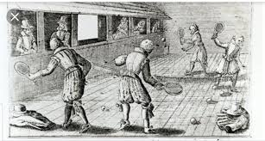
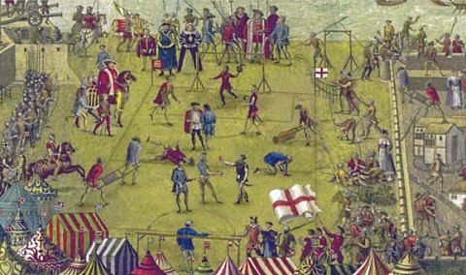
Key Topic 3.1: Education and Leisure
B. Sport, pastimes and theatre
Leisure
As with many other aspects of life in Elizabethan times, your social class and gender could determine what sports and leisure activities you could participate in. Generally, the wealthier class had greater access to leisure pursuits. When it came to taking part in sports, there were more options for men than women.
Participation in leisure – sport
Nobility and gentry
Sports played by the nobility and gentry included:
Hunting on horseback, with hounds (both men and women)
Hawking (men and women)
Fishing (men and women)
Fencing (men)
Real tennis (men)
A 16th century engraving of real tennis.
There were some sports that were played by men of all social classes, however, they would not take part together. Wrestling and swimming were popular with men of all classes. In terms of wrestling, the men of the lower social class would take part in public wrestling matches and gambling on the outcome was popular, with the nobility and gentry betting alongside other classes. However, in terms of participation, the noblemen would wrestle in private.
Working people: craftsmen, farmers and labourers
Football was a lower class game for men. It was extremely violent. It was not unknown for men to be killed during matches, which could last for houses. The aim of the game was similar to football matches today: to get the ball into the other side’s goal. However, unlike today, the goals themselves came in all shapes and sizes. Football did not resemble the modern game. There were no rules against:
Picking up the ball and running with it
The number of players
Tripping up the opposing team’s players
The size of pitch
Sometimes the streets were pitches, sometimes it was the countryside between two opposing village teams. In fact, there were no rules. Because of the random nature of the pitches, there were not set positions.
TASK: In your own words, using specific detail, write 2 sentences showing what sports people participated in. Be specific about which gender and which class took part in these sports.
In Elizabethan England, there was a variety of sports played by people. For example ____________________________________
________________________________________________________________________________________________________________________________________________________________________________________________________________________________________________________________________________________________________________________________________________________________________________________________

Slide 19
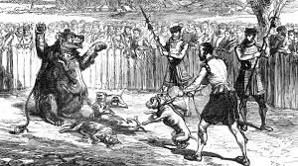
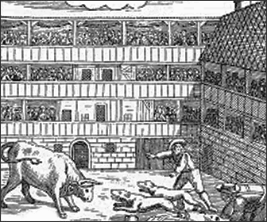
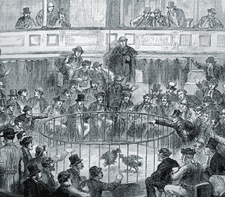
Key Topic 3.1: Education and Leisure
B. Sport, pastimes and theatre
Spectator Sports
Depending on their class, Elizabethans enjoyed watching certain sporting competitions such as wrestling or tennis. Watching animals fight to the death was also considered entertainment and people of all classes would watch, even Elizabeth I. Often, large sums of money would be gambled on the outcomes.
Baiting
Bear baiting was so popular in Elizabethan England that special arenas were built in London to house them. All classes of people enjoyed watching what they considered to be a sport, including the queen.
Baiting involved chaining a bear to a post and unleashing dogs against the bear. The bears teeth would be broken short so that they could not bite the dogs, though, many dogs were kills as the bear lashed out and pinned the dogs with their paws. Care was taken to not kill the bears as they were very expensive.
Bull baiting was also popular. Most towns had a bull ring. As bulls were neither rare nor expensive, the fight was to the death. Yet again, dogs were set upon a chained bull. The bull would use its horns to fight them off, sending the dogs flying.
Cock-fighting
Cockerels are aggressive birds and when cock-fighting, were made to wear metal spurs to attack each other, as well as using their beaks. Many places around England, including in small towns, had special arenas built for cock-fighting. Like baiting, all classes enjoyed it and bet hug sums on the out comes of the fights.
However, baiting and cock-fighting were not approved by all Elizabethans. Puritans especially disapproved of
Them, although not because they felt the animals were being harmed or mistreated. The main reason why they disproved was because the fights took place on a Sunday, which was they considered a holy day.

Slide 20
Key Topic 3.1: Education and Leisure
B. Sport, pastimes and theatre
TASK: Read the paragraph below regarding spectator sports. Find the incomplete sentence fragments in the paragraph, highlight them, then correct them in the table below. One has been done for you.
In Elizabethan England, people enjoyed watching a variety of different sporting competitions such as wrestling and tennis. However, this depended upon your social class though watching animals fight to the death was considered entertainment for all. Baiting was when. It was so popular that within Elizabethan England there were special arenas built to house them. All classes enjoyed. Cock-fighting was also another popular spectator sport. This was where cockerels, who were aggressive in nature. Despite the general popularity of these sport, not everyone approved of them. Puritans disapproved of them, not because of the animal cruelty.
Fragment | Correction
Baiting was when. | Baiting was when a bear would be tied to a post and dogs were unleashed against it.
HOT: Are there any modern day examples of spectators sports that are similar in nature? Make a list below.
________________________________________________________________________________________________________________________________________________________________________________________________________________________________________________________________
What is your view on these kinds of sports?
________________________________________________________________________________________________________________________________________________________________________________________________________________________________________________________________

Slide 21
Key Topic 3.1: Education and Leisure
B. Sport, pastimes and theatre
Pastimes
Literature
There was a lot of new literature written during Elizabeth I’s reign. History was a very popular subject, as were accounts of voyages of discovery, and translations of Latin and Greek Classics. Medieval works such as Canterbury Tales, written by Chaucer, were also popular.
Poetry and plays were the most popular forms of creative writing with most of the well-educated people writing their own, including the queen. Theatre, meanwhile, was undergoing a revolution in Elizabeth I’s reign.
Theatre
Due to the Protestant reformation and the impact it had on Elizabethan life, theatre developed during this time. At the beginning of Elizabeth’s reign, mystery plays were the most common and popular in theatres. This was a result of these plays bringing Bible and saints’ stories to life for an audience. Some Protestants believed this was another way for the Catholic Church to control interpretations of the Bible.
Saints were an important part of the Catholic religion, and the plays kept their memories (and miracles) in the public imagination. There was also apprehension from Elizabeth that these places would encourage religious violence, so her government put a stop to them. Theatre instead turned their focus to new, secular plays.
These secular plays were popular and were in great demand. They were more exciting and vibrant then the older religious plays, as unlike Bible stories, the endings were not already known. Comedies was another popular medium, the Elizabethans had a rude and vulgar sense of humour. The demanded for theatre rocketed and theatre companies were formed across England. They were usually established and funded by members of the nobility. The Earl of Leicester, for example, had his own company called Leister’s Men. On top of this, in 1583, Elizabeth I established The Queen’s Men.
The popularity of plays led to the first purpose-built theatres being constructed. Originally, plays were performed in the courtyards of inns that had high galleries surrounding them, so the audience looked down on the action. However, due the popularity and therefore the increase of money earned, purpose-built theatres began to appear. Many of the theatres were built in London: the first purpose –built theatre was the Red Lion in Whitechapel, constructed in 1567. Others included the Rose in 1587, not far from where the modern reconstruction of Shakespeare’s Globe theatre is today.
Even though the theatre was popular with all classes and men and women respectively, only men were allowed to act. Women’s parts were taken by boys. Well-known performers attracted large audiences and sometimes, there were queues of 2,000 people waiting to see a performance. Poor people had access to theatres by paying 1 penny to stand in the pit in the front of the stage.
Seats were very expensive. The most expensive place to sit was directly above the stage. This was not where the best view of the action was, but the important thing was to be seen sitting there by the rest of the audience.

Slide 22
Key Topic 3.1: Education and Leisure
B. Sport, pastimes and theatre
TASK: Describe two features of theatres in Elizabethan London.
Feature 1: ___________________________________________________________________________________________________________________
________________________________________________________________________________________________________________________________________________________________________________________________________________________________________________________________________________________________________________________________________________________________________________________________
Feature 2: ___________________________________________________________________________________________________________________
________________________________________________________________________________________________________________________________________________________________________________________________________________________________________________________________________________________________________________________________________________________________________________________________
What made going to the theatre so popular? ______________________________________________________________________________
________________________________________________________________________________________________________________________________________________________________________________________________________________________________________________________________
How did theatres change during this period? _____________________________________________________________________________
________________________________________________________________________________________________________________________________________________________________________________________________________________________________________________________________________________________________________________________________________________________________________________________________
Music and Dancing
Elizabethans of all classes were passionate about music. Many people played instruments. These instruments were not too different from the ones that we use today. For example, there were lutes that are similar to guitars, spinets and harpsichords were also played which are similar to pianos. These were expensive instruments and would be found in noble and upper class households. Bagpipes and fiddles were especially popular with the lower classes.
Listening to live music was also hugely popular. Wealthy families would employ their own musicians to play during meals and feasts, though only men could be paid musicians. For the lower class, they would listen to live music in open, public events such as fairs and markets. Towns employed musicians to play at official functions or public events. There was also music in churches, taverns, barbers’ shops and the streets and it was possible to buy books of popular songs.
Like theatre, new music was being composed to compliment the new secular society. There were developments in musical instruments which led to new music being composed and heard through England.
Dancing was a very popular and, although upper and lower class people did not dance together, it did bring men and women together.

Slide 23
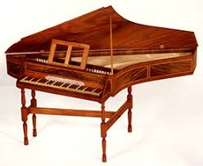
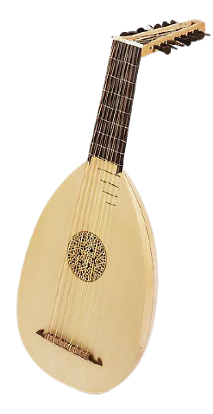
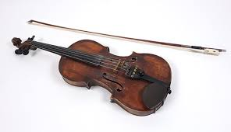
Key Topic 3.1: Education and Leisure
B. Sport, pastimes and theatre
An English Spinet
Lute
Fiddle
TASK: Answer the following questions regarding music and dancing
What instruments did the upper class play? __________________________________________________________________________
What instruments did the lower class play? __________________________________________________________________________
How was listening to music different depending on which class you were? ________________________________________ ____________________________________________________________________________________________________________________________________________________________________________________________________________________________________________________________________________________________________________________________________________________________________________________
TASK: Sport, pastimes and the theatre. Complete the Venn diagram below by placing sports, pastimes and the theatre in the correct heading on the diagram.
Lords and gentry and their families
Everyone
Working people, their families and the unemployed.

Slide 24
Key Topic 3.1: Education and Leisure
B. Sport, pastimes and theatre
Interpretation 1
Historian Andrew Wilson interprets Elizabethan England as one which changed dramatically, in the book The Elizabethans (2011) What instruments did the lower class play?
There were new schools… English ships – sailed to new lands, and brought back… the sense of an expanded world. In churches, halls, palaces and country houses, new music delighted the ear. You could not be alive in Elizabethan England and not feel that it was a young country full of capacity to reinvent itself.
TASK: What impression does Andrew Wilson give of life in Elizabethan England?
________________________________________________________________________________________________________________________________________________________________________________________________________________________________________________________________
Which phrases or words support your answer to the previous question?
________________________________________________________________________________________________________________________________________________________________________________________________________________________________________________________________
TASK: ‘There were plenty of opportunities to enjoy life when you were not working’ Using the information in your Venn diagram and interpretation 1, write a paragraph developing or correcting the statement above, using the evidence.
________________________________________________________________________________________________________________________________________________________________________________________________________________________________________________________________________________________________________________________________________________________________________________________________________________________________________________________________________________________________________________________________
________________________________________________________________________________________________________________________________________________________________________________________________________________________________________________________________________________________________________________________________________________________________________________________________________________________________________________________________________________________________________________________________
________________________________________________________________________________________________________________________________________________________________________________________________________________________________________________________________________________________________________________________________________________________________________________________________________________________________________________________________________________________________________________________________
________________________________________________________________________________________________________________________________________________________________________________________________________________________________________________________________________________________________________________________________________________________________________________________________________________________________________________________________________________________________________________________________

Slide 25
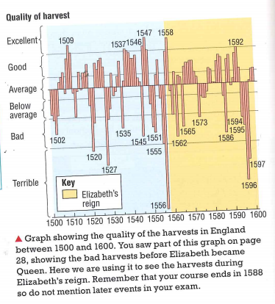
Key Topic 3.2 The problem of the poor
A. The reasons for the increase in poverty and vagabondage during these years.
Reasons for the increase in poverty and vagabondage
TASK: Summarise each reason for the increase in poverty.
Harvests
Everyone in Elizabethan England were depended on food grown by farmers, however, the farmers were dependent on the weather. When there was a bad harvest, people were in danger of starvation. You can see from the graph on the right that the worst harvests of the century was in 1556, just before Elizabeth became Queen. You can also see from the graph that there were two really bad sequences of harvest, in early 1570s and the mid-1590s. Food shortages would occur when there was a bad harvest and this resulted in the price of foot doing up. At these times, it was the poor who struggled and suffered the most because they couldn’t afford the increase in bread prices.
Summery:
Changes in Farming
During this period, many farmers looked to find more profitable ways to earn their living, they did this by switching to different methods of agriculture. One method was to enclose land with hedges and put sheep on it instead of growing crops. This saved the farmers money because they didn’t have to employ labourers to work the land. However, those labourers who had worked, lost their jobs and their homes, and as a result, many moved to towns hoping to find work.
Enclosing land encouraged more sheep farming. English wool and woollen cloth accounted for 81.6% of England’s exports during Elizabeth’s reign. The price of wool increased as demand for woollen cloth grew. This meant that farming sheep was profitable. Finally, some farmers began to control animal breeding to produce better livestock, this meant that they needed to keep them in enclosed fields to stop them wandering off.
Enclosures were needed due to the new farming techniques that were being developed at this time. For example, there was an improvement in land drainage and use of fertiliser, which produced more crops, and enclosed farms made it easier to drain and made planting and caring for larger crops easier. These more efficient techniques in farming led to an increase in poverty because fewer labourers were needed, which reduced landowner costs.

Slide 26
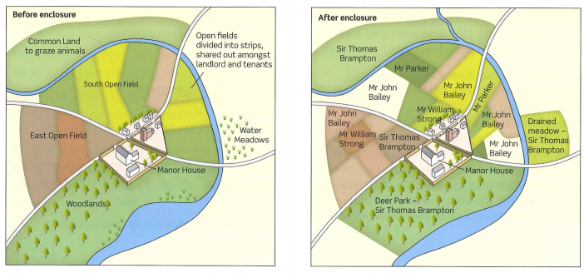
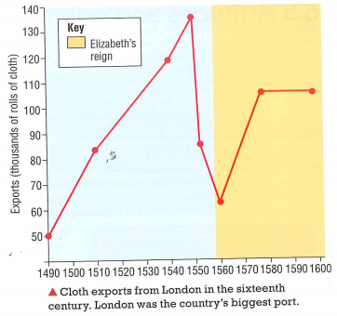
Key Topic 3.2 The problem of the poor
A. The reasons for the increase in poverty and vagabondage during these years.
Some landlords also increased the rent on the lands they rented out to farmers. This was called rack-renting. Many farmers could not afford to pay these higher rents, so they too moved to towns in search of work.
The images on below show the impact of enclosures on a village.
Summery:
Unemployment in industries
The only important industry in the sixteenth century was the cloth trade, where English woollen cloth was exported to Europe. This had provided work for many spinners and weavers. When the cloth trade collapsed in 1550s (see the graph on the right), tens of thousands of people lost their job.
Summery:

Slide 27
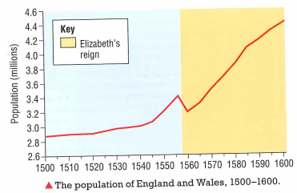
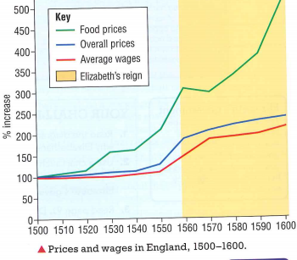
Key Topic 3.2 The problem of the poor
A. The reasons for the increase in poverty and vagabondage during these years.
More and more people
At the time of the Black death in 1348039, England's population had fallen by nearly a half. It remained low until the sixteenth century, when it began to increase. You can see in the table to the right that there was sharp increase in population during Elizabeth’s reign. As a result of the rising population, more jobs were needed, but as you have learned already, there were fewer jobs in farming and the cloth industry. More and more people could not find work, so could not earn money,.
Summery:
Inflation – rising prices
Another problem creating poverty was inflation – prices were going up all across Europe. If you look at the graph to the right, you can see the bottom line represents the average rage. It began to go up at the beginning of Elizabeth’s reign but by 1570, the increase became slower. However, the prices increased, especially the price of food and as the graph shows you (the top line), it increased sharply. The result of this, as you can tell, is that those on lower wages struggled to afford even basic food. Prices might be going up, but their wages were not. Although historians do not
all agree about the causes of inflation, most think that it was caused by an increase in demand for goods such as food, probably due to the growing population, and an inability to produce enough to meet this demand.
Henry VII’s debasement of the coinage in the 1540s, when he ordered all the coins to be melted down, also played a part in the rise in prices from the middle of the sixteenth century. These coins had contained precious metal like gold or silver, but when new coins were minted, they contained far less gold and silver. Henry made himself nearly a million pounds, but he had ‘debased’ the coinage. After this, people no longer trusted its value, so merchants and shopkeepers began to put up prices to they felt they were getting the same value for they sold.

Slide 28
Key Topic 3.2 The problem of the poor
A. The reasons for the increase in poverty and vagabondage during these years.
Summery:
The closure of the monasteries
Until the 1530s, the monasteries provided food and shelter for the homeless and unemployed. However, they were closed down by Henry VIII in the late 1530s. This Dissolution of the Monasteries meant there was less help for the poor, and many of them were left to wander the roads or drift to the towns in search of work.
Summery:
TASK: Below are 3 simple statements, you need to extend them to form complex sentence based on what you have just read.
Simple Sentence
There were bad harvests which caused poverty.
Farming also changed.
The price of food went up.
Complex Sentence
______________________________________________________________________________________________________________________________________________________________________________________________________________________________________________________
______________________________________________________________________________________________________________________________________________________________________________________________________________________________________________________
______________________________________________________________________________________________________________________________________________________________________________________________________________________________________________________

Slide 29
Key Topic 3.2 The problem of the poor
A. The reasons for the increase in poverty and vagabondage during these years.
TASK: ‘Fewer people were poor during Elizabeth's reign’. Using the information on the previous pages, place evidence that supports this statement and evidence that challenges this statement in the table below.
Evidence supporting the statement | Evidence challenging the statement
TASK: ‘Fewer people were poor during Elizabeth's reign’. Write a paragraph developing or correcting the statement, using evidence in your chart.
________________________________________________________________________________________________________________________________________________________________________________________________________________________________________________________________________________________________________________________________________________________________________________________________________________________________________________________________________________________________________________________________
________________________________________________________________________________________________________________________________________________________________________________________________________________________________________________________________
________________________________________________________________________________________________________________________________________________________________________________________________________________________________________________________________
________________________________________________________________________________________________________________________________________________________________________________________________________________________________________________________________

Slide 30

Key Topic 3.2 The problem of the poor
A. The reasons for the increase in poverty and vagabondage during these years.
TASK: Draw a spider diagram to summarise the causes of poverty. One has been done for you. Make sure you add how it led to an increase in poverty. HOT: draw an image that represent each cause.
People were reliant on food grown
There were 2 bad harvests during Elizabeth’s reign (1570s +1590s)
A bad harvest meant more starvation
Harvests
Food prices would go up as a result of a bad harvest
Causes of Poverty

Slide 31
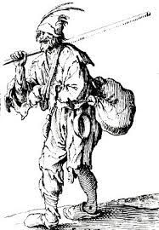
Key Topic 3.2 The problem of the poor
A. The reasons for the increase in poverty and vagabondage during these years.
Reasons for the increase in Vagabondage
Vagabondage was something that greatly concerned Elizabethans, especially the government and nobility. Elizabethan society had a strict hierarchy in which everyone had a place. Vagabonds lived outside this hierarchy as they had no place – no employer, no master, no place where they belonged. They often lived outside the law, too. Therefore, Elizabethan society feared vagabonds as they threatened law and order.
The Urban Poor
Rural depopulation made the problem of vagabondage worse. Many people left their home villages to look for work in towns and cities. However, city life could be hard, especially when there was an economic recession, for example when poor relations between England and Spain led to trade embargos with the Netherlands and big increases in unemployment. This resulted in many people who had left their villages becoming beggars or turning toa life of crime. Outside London’s city walls, the poor built shacks which were tightly packed together. As they were outside the city, they were outside the authority of government officials. Crime and disorder were rife. All towns faced similar problems.
The number of urban poor grew very fast. Until Elizabethan times, it was thought that people who were able to work (but didn’t) were simply idle. Elizabeth I’s government eventually came to recognise that unemployment was a genuine problem. In many places, there were not enough jobs. Nevertheless, they continued to treat vagrants harshly.
TASK: Answer the following questions based on the increase in Vagabondage.
1. Why did people fear vagabonds?
2. How did rural depopulation make the problem worse?
3. What problems did all towns and cities face?
4. What was the Elizabethan view of people that didn’t work?
Key Word
Vagabonds: Vagabonds, or vagrants, were homeless people without jobs, who roamed the countryside begging for money, perhaps stealing or committing other crimes in order to survive.

Slide 32
Key Topic 3.2 The problem of the poor
A. The reasons for the increase in poverty and vagabondage during these years.
TASK: Create a flow chart to show how an increase in population led to rising prices, which in turn led to enclosure then unemployment, vagabondage. You need to included images to the side that represents what you have written.

Slide 33
Key Topic 3.2 The problem of the poor
B. The changing attitudes and policies towards the poor.
Changing attitudes and policies towards the poor
Government Action
Although poor relief was a local issue, dealt with in a variety of ways in different places, Elizabeth I’s government also adopted a more national approach across the whole country. When Elizabeth came to the throne, local officials had the power to collect poor rates on a weekly basis, as necessary, and distribute it to the impotent poor. However, vagrants were whipped and expelled from the parish if they had not been born there.
New laws were passed by Elizabeth's I’s Parliament. The main reason for some of the Acts of Parliament was fear of vagrancy and social unrest. However, they also show changes in how the poor were seen, with unemployment being recognised as a problem that needed to be tackled. The 1572 Vagabonds Act was a turning point, at as it established national poor rate for the first time. It also recognised unemployment as a real problem, because it gave towns the responsibility of providing work to the able bodied poor rather than simply punishing them for their circumstances.
1563 Statute of Artificers | 1572 Vagabonds Act | 1576 Poor Relief Act
Aim: to ensure the poor relief was collected. Features: Anyone who refused to pay the poor rates could be imprisoned. Officials failing to organise poor relief could be fined up to £20 | Aim: to deter vagrancy. Features: The Act stated that vagrants were to be whipped and a hole drilled through each year. Vagrants were also to be imprisoned if arrested a second time for vagrancy and given the death penalty for the third. ALSO It established the national poor rate for the first time. This sheltered the impotent poor JPs were to keep a register of the poor Towns and cities were given the responsibility to find work for the able-bodied bodied poor. | Aim: to distinguish between able bodied and impotent poor, and to help the able bodied poor find work. Features: JPS provided the able bodied poor with wool and raw materials to enable them to work by making things to sell. Those who refused work where they were given help to be sent to a special prison funded by poor rates, known as the house of correction.

Slide 34
Key Topic 3.2 The problem of the poor
B. The changing attitudes and policies towards the poor.
The Impact of the Elizabethan poor laws
Although there were changes for the better, poverty continued to be a major problem throughout Elizabeth I’s reign. This was because of the conflict with Spain and the revolt in the Netherlands, which hit trade in England badly. Pamphlet writers stirred up fear of vagabonds, as more and more people appeared in towns and cities looking for work. Although they were a real problem, ordinary Elizabethans were often sympathetic. Some local records show that less than 10% of vagrants were whipped in some towns. In most cases, they were given money and sent on their way. This was often cheaper for the parish than whipping the vagrants and sending them back to their home parish.
The most important change to Elizabethan poor laws was he recognition of unemployment as a genuine problem: it was not simply laziness. Providing the poor with a way to make things to sell became the law across England. This helped the unemployed keep some independence and dignity, and often enabled them to stay in their hometown or village. It formed an important part of poor relief until the 19th century.
TASK: Below are a list of statements that refer to one of the 3 laws that Elizabeth passed, you need to say which one it refers to. One has been done for you.
Established in 1572 | Vagabonds Act
Anyone who refused to pay the poor rates could be imprisoned.
The aim was to distinguish between the able bodied and impotent poor and to help the able bodied find work.
Those who refused work where they were given help to be sent to a special prison funded by poor rates.
It stated that vagrants were to be whipped and a hole drilled through each year.
JPs were to keep a register of the poor.
Officials failing to organise poor relief could be fined up to £20
TASK: Which of the 3 laws passed do you think was the most successful at dealing with the problem of the poor? Why did you choose the one you did?
________________________________________________________________________________________________________________________________________________________________________________________________________________________________________________________________________________________________________________________________________________________________________________________________________________________________________________________________________________________________________________________________________________________________________________________________________________________________________________________________________________________________________________________________________________________________________________________________

Slide 35


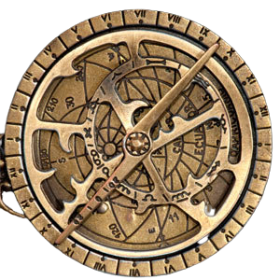
Key Topic 3.3 Exploration and voyage of discovery
A. Factors prompting exploration, including the impact of new technology on ships and sailing and the drive to expand trade.
Reasons for the growth of overseas exploration during Elizabeth’s reign.
TASK: Match the headings below to the paragraphs.
Conflict with Spain | Opportunity to make money | New learning and knowledge | Duty to civilise other cultures
Increased experience of sailors | New technology in ships and sailing | Desire to spread Protestantism | Expansion of trade
TITLE: ______________________________________________________________________________________
The growing wealth and power of Catholic Spain was based on the gold and silver mines of Spanish territories in the New World, mainly Mexico and Peru. The English desire to attack and plunder these territories increased s relations with Spain grew worse in the 1580s and English fears of a Catholic invasion grew. English explorers (pirates, in the eyes of the Spanish), like John Hawkins and Francis Drake, took no notice of trade restrictions on Spanish territories, especially once it was clear that Spain was no longer England’s ally.
TITLE: ______________________________________________________________________________________
By the middle of the sixteenth century, developments in the design of ships and the navigational instruments they carried meant that sailors could make longer voyages than ever before. In 1569, the Flemish mapmaker, Geradus Mercator, introduced sea charts showing the parallels of latitude and longitude. Elizabethan sailors could now use an astrolabe to determine their latitude by measuring the angle between the horizon and the North Star. The use of the astrolabe, however, depended on visibility, so Elizabethan sailors tended to rely more on the magnetic compass. Again, these were not new, and it had long been realised that the magnetic north which the compass needle pointed to was not true north.
English sailors also benefited from the new technology in shipbuilding developed by the Portuguese earlier in the century to produce the massive galleon and the more compact caravel. These two new designs enabled expeditions to be planned across the Atlantic with stronger and faster ships, with an increased carrying capacity. Ships were now fitted with triangular sails, which could easily by turned to catch the strong winds of the open seas, and with sophisticated artillery, including the more rapid-firing guns.

Slide 36




Key Topic 3.3 Exploration and voyage of discovery
A. Factors prompting exploration, including the impact of new technology on ships and sailing and the drive to expand trade.
TITLE: ______________________________________________________________________________________
Before the 1550s, nearly all English trade was concentrated on exporting woollen cloth to Europe; this had accounted for 75 per cent of all exports and brought in annual custom duties of between £35,000 and £50,000. Once this trade collapsed, English merchants needed to find new markets to sell their goods. This motivated journeys overland, as well as overseas, with some Elizabethan explorers establishing trade agreements with countries as far away as Russia and India. The most lucrative form of trade, however, was the illegal trade of selling items, including slaves, to the Spanish colonists in the New World.
TITLE: ______________________________________________________________________________________
Many of the English upper classes, including the Queen, were prepared to put up the money for overseas voyages as a way of making a quick profit. Attacks on Spanish cargo ships, like the Cacafuego, carrying gold and silver to Europe, resulted in a fast and big profit for any investors, although they were technically acts of piracy. At a lower level, signing on as a sailor ensured a regular wage and offered a way out of the poverty experienced by some of the labouring classes, especially those living near ports.
TITLE: ______________________________________________________________________________________
Converting heathen lands to Christianity had long been the motive behind many of the earlier Spanish expeditions. Individual popes had blessed those Jesuit priests who undertook terrifying journeys as missionaries in far-off lands. Elizabethan explorers were no different, although their aim was to spread Protestantism, and in their case, this was to be largely achieved by holding back the continuing expansion of their Catholic enemies.
TITLE: ______________________________________________________________________________________
The increase in learning due to the ideas of the Renaissance encouraged a thirst for knowledge and adventure that drove curious Elizabethans to explore beyond the limits of their own known world. Many believed there was a route westwards across the Atlantic that would lead directly to the riches of the East, places like China and India. The invention of the printing press enabled books to reach a wider audience, such as Richard Hakluyt’s The Principal Navigations, Voyages and Discoveries of the English Nation, which urged sailors to go on longer voyages. Some gentlemen-a-arms, like Francis Petty who sailed with Drake, kept logs of their voyages; and , of course, men like Drake and Raleigh acted as role models for others who looked o expand their horizons.

Slide 37


Key Topic 3.3 Exploration and voyage of discovery
A. Factors prompting exploration, including the impact of new technology on ships and sailing and the drive to expand trade.
TITLE: ______________________________________________________________________________________
The confident Elizabethans felt it was their duty to spread the advantage of their age and country to other lands. Raleigh named the first American colony ‘Virginia’, in honour of the Virgin Queen. Elizabethan explorers believed the Native Americans could only benefit from their civilising influence, as these extracts from Richard Hakluyt show:
All savages, so soon as they begin to taste of civilisation, will take marvellous delight in any garment – as a shirt, a gown a cap or suchlike. But that is not all the benefit which they shall receive; they shall be reduced from unseemly customs to honest manners, from disordered riotous routs […] to a well governed commonwealth.
TITLE: ______________________________________________________________________________________
English seamen were well trained, as most had grown up in seafaring communities on the coast and had worked as merchant seamen. They were often used to smuggling or even piracy. Experienced captains such as Drake and Hawkins were not just successful in leading overseas voyages, they also inspired great loyalty and affection from their crews, who were prepared to follow them anywhere.
TASK: Using the information you have just read, complete the table below.
Conflict with Spain Give two reasons why dislike of Spain was a reason for voyages to the New World. | New technology in ships and sailing Pick two inventions or developments that helped Elizabethan sailors to go further.
Expansion of trade Explain why the English needed to find new markets to buy and sell goods. | Opportunity to make money Who supported these voyages because they hoped to make money from them?

Slide 38
Key Topic 3.3 Exploration and voyage of discovery
A. Factors prompting exploration, including the impact of new technology on ships and sailing and the drive to expand trade.
Desire to spread Protestantism Explain why religion was a motive for overseas voyages. | New learning and knowledge Which new things were Elizabethans keen to learn from these voyages?
Duty to civilise other cultures What did Elizabethans believe it was their duty to do overseas? | Increased experience of sailors Why were English sailors keen to go on voyages of exploration overseas?
TASK: The chart below shows three categories of reasons why voyages took place. Decide which headings and paragraphs should go in each column of the table. Some of the reasons may fit in more than one category. You need to give a small summary of the reasons why in the box.
Financial and military motives | To spread ideas and influence | Technical and educational reasons
Expansion of trade After the collapse of the cloth market at Antwerp the English had to find new countries to trade with. Selling slaves to the settlers in the Spanish New World brought in huge profits, but was illegal.

Slide 39
Key Topic 3.3 Exploration and voyage of discovery
A. Factors prompting exploration, including the impact of new technology on ships and sailing and the drive to expand trade.
Financial and military motives | To spread ideas and influence | Technical and educational reasons
EXAM QUESTION: Explain why English sailors went on so many voyages of discovery during Elizabeth’s reign. You may use the following in your answer:
Financial and military motives
To spread ideas and influence
You must use information of you own.
TASK: Look at the model paragraph below. Choose 3 colours and highlight the point, evidence and explanation.
Model Paragraph 1
One reason that voyages of discovery too place during Elizabethan times is because Navigation had become much easier. Thomas Harriot had worked out an easier way to navigate using the Sun, which meant it was easier for sailors to work out where they were going. Sailors could also use astrolabes and quadrants to further help make sure their ships position was accurate by measuring their position against the stars. More books were also printed of these journeys making it easier for others to follow these directions. This meant more people were likely to explore new places and undertake voyages as there was more certainty that their voyage would be successful.

Slide 40
Key Topic 3.3 Exploration and voyage of discovery
A. Factors prompting exploration, including the impact of new technology on ships and sailing and the drive to expand trade.
TASK: Look at the second model paragraph below. Some of the sentences are incomplete. Highlight the sentence that is incomplete and below, complete the sentence.
Model Paragraph 2
Another reason why voyages and discovery took place during Elizabethan times was because of new opportunities to trade. As the ‘New World’ was discovered, England wanted to develop new products to buy and sell. These opportunities meant that courtiers were willing fund these voyages as there was a chance of getting rich as a result of new trade. Spain had become rich from new trades such as. In addition to this, there was still lots of areas of ‘The New World’ to explore. This meant that there was lots of opportunities.
____________________________________________________________________________________________________________________________________________________________________________________________________________________________________________________________________________________________________________________________________________________________________________________
____________________________________________________________________________________________________________________________________________________________________________________________________________________________________________________________________________________________________________________________________________________________________________________
____________________________________________________________________________________________________________________________________________________________________________________________________________________________________________________________________________________________________________________________________________________________________________________
TASK: Complete a final paragraph in your assessment books.

Slide 41
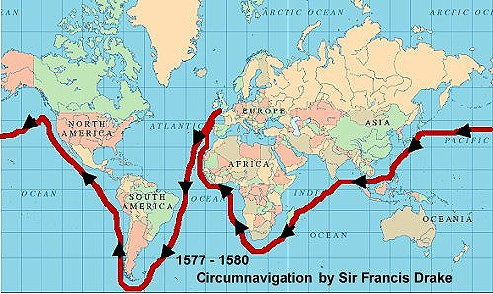
Key Topic 3.3 Exploration and voyage of discovery
B. The reasons for and significance of Drake’s circumnavigation of the globe
Drake’s circumnavigation of the globe
Drake’s circumnavigation of the globe took almost three years, from December 1577 until September 1580. Following this achievement, he was knighted by Elizabeth I.
Why did Drake circumnavigate the globe?
Drake had not set out with the aim of being the first Englishman to sail around the world. His main purpose was to raid Spanish colonies in the Pacific. Relations with Spain were deteriorating at this time and this appears to have been upmost in the queen’s mind.
Interpretations 1 suggests that Elizabeth I was not alone in wanting revenge on the Spanish. By 1578, relations between England and Spain were poor, and getting worse. Drake also wanted revenge. In 1567-68, he had accompanied John Hawkins on a third trans-Atlantic expedition. This time the Spanish, angered at English attempts to break Spain’s trading monopoly in the New World, were prepared for battle. The English were attacked at St Juan de Ulua. Their fleet was devastated and 325 of their sailors were killed. Force to abandon some of his remaining men, Hawkins and Drake returned home with only 15 sailors.
Interpretation 1
C.E. Hamshere plays down the significance of Drake’s circumnavigation of the globe as a happy accident in the book Drake’s Voyage Around the World (1967)
What is fairly evident is that Drake did not set out to perform the feat of circumnavigation. He probably carried the possibility in the back of his mind, but his prime object was to plunder the Spaniards, not to make a voyage of exploration. The discoveries he did make were incidental.
Although Drake and Elizabeth had political reasons for (what turned out to be) the circumnavigation, there were still great profits to be made from the journey into the Americas, and there were plenty of people willing to invest in his expedition at court. Despite the long and difficult voyage, Drake returned to England a rich, and famous, man. He also made his investors very rich. Some estimates put Drake’s treasure haul at £500.000,000 in today’s money!

Slide 42



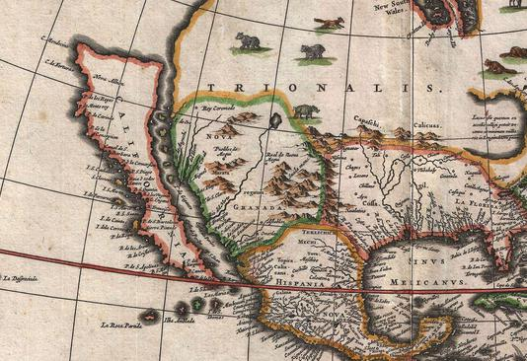
Key Topic 3.3 Exploration and voyage of discovery
B. The reasons for and significance of Drake’s circumnavigation of the globe
What was the significance of Drake’s circumnavigation?
England as a great sea-faring nation
Drake's voyage almost ended in disaster. He set out with five ships and, by the time he had reached the Pacific in 1578, he had only one left: The Golden Hind. One sailor, Captain Thomas Doughty, was executed on the voyage. Doughty had been accused of mutiny by Drake.
Despite this, he and his 56 surviving men managed to return to England in 1580 after circumnavigating the globe. They were only the second crew in history to have achieved such a feat. This was a great boost to English morale and established the reputation of English ships and sailors as being among the finest in the world. This was important at a time of growing fears that the Spanish could invade England at any time
Encouraging explorations
Drake and his crew survived in part by raiding Spanish ships and colonies up the coast of South America. How far north they then travelled has been debated, but it is believed that they made it as far north as Vancouver. They gathered a great deal of useful information about the Americas, as well as keeping thorough logs of their voyage that could be written up and shared with other English sailors.
Nova Albion
In June 1579, the Golden Hind was in urgent need of repair after having explored the furthest reaches of North America’s Pacific coast. Drake landed in a bay that was probably north of modern-day San Francisco. The local Native Americans treated the English with great hospitality. They performed a ceremony that Drake took to be the equivalent of a coronation. He therefore named the region Nova Albion and declared Elizabeth I to be its sovereign.

Slide 43
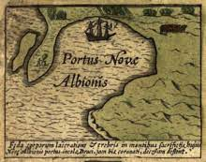


Key Topic 3.3 Exploration and voyage of discovery
B. The reasons for and significance of Drake’s circumnavigation of the globe
Nova Albion
Elizabeth I and other European rulers did not recognise the agreement made by the pope almost a century earlier that gave the Americas to the Spanish and Portuguese. Elizabeth herself gave her explorers the right to take any land that no other Christian leader had claimed. The existing rights of the Native Americans (already living there_ to the land were not considered. The peaceful welcome given to Drake in what was later called California encouraged the idea that Europeans could settle, and even rule, there.
Encouraging colonies in America
Although there were already plans being made to establish English colonies in the Americas, by the early 1570s, they had come to nothing. In 1578, while Drake was undertaking his circumnavigation, Elizabeth I gave Sir Humfrey Gilbert permission to set out on a voyage of discovery to North America. It ended in disaster. Gilbert was bankrupted. Yet in 1583, he was prepared to set out again. Since Gilbert’s earlier failure, Drake had returned to England with wealth and reports that encouraged adventurers and investors to continue trying to establish their own colonies there.
Anglo-Spanish damaged relations
Drake was correct when he said that attacking Spain’s American colonies would anger Philip II. The following year, Elizabeth I knighted Drake on the Golden Hind. This sent a clear message to Philip II. He regarded Drake as a pirate and Elizabeth’s provocative actions as scandalous. It was one more event in deteriorating Anglo-Spanish relations.

Slide 44
Key Topic 3.3 Exploration and voyage of discovery
B. The reasons for and significance of Drake’s circumnavigation of the globe
TASK: Using the information on the previous pages, create a mind map showing the significance of each of the factors for why Drake’s circumnavigation was significant. Make sure you put specific information
England as a great sea-faring nation
Encouraging exploration
Anglo-Spanish damaged relations
What was the significance of Drake’s circumnavigation?
Nova Albion
Encouraging colonies in America

Slide 45
Key Topic 3.3 Exploration and voyage of discovery
B. The reasons for and significance of Drake’s circumnavigation of the globe
TASK: How far did Drake achieve his aims during his circumnavigation of the globe? On the left of the table below are Drake’s aims. Use specific information to show if Drake achieved those aims.
Drakes Aim | Evidence of success | Evidence of failure | Overall judgement
He wanted revenge for the Spanish attack on Hawkins fleet in 1568. He planned to attack the Spanish settlements in Central America, where the Spanish had few defences.
He wanted to capture gold, silver and other riches.
As a Puritan, Drake wanted to cause damage to Spain because it was the most powerful Catholic country in the world.
He hoped to find new lands to claim for the Queen.
Drake wanted to establish new and better trade routes and find new markets where English merchants could sell their good overseas.

Slide 46
Key Topic 3.3 Exploration and voyage of discovery
B. The reasons for and significance of Drake’s circumnavigation of the globe
TASK: Overall, how successful was Drake in achieving his aims?
________________________________________________________________________________________________________________________________________________________________________________________________________________________________________________________________________________________________________________________________________________________________________________________________________________________________________________________________________________________________________________________________________________________________________________________________________________________________________________________________________________________________________________________________________________________________________________________________
________________________________________________________________________________________________________________________________________________________________________________________________________________________________________________________________________________________________________________________________________________________________________________________________
________________________________________________________________________________________________________________________________________________________________________________________________________________________________________________________________________________________________________________________________________________________________________________________________
Exam Practice: Describe two features of Drakes circumnavigation of the globe.
Feature 1: ___________________________________________________________________________________________________________________
________________________________________________________________________________________________________________________________________________________________________________________________________________________________________________________________________________________________________________________________________________________________________________________________________________________________________________________________________________________________________________________________
Feature 2: ___________________________________________________________________________________________________________________
________________________________________________________________________________________________________________________________________________________________________________________________________________________________________________________________________________________________________________________________________________________________________________________________
________________________________________________________________________________________________________________________________

Slide 47
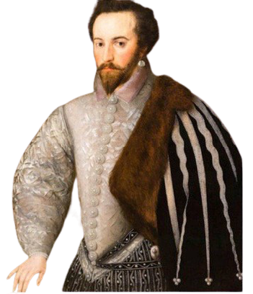
Key Topic 3.4 Raleigh and Virginia
A. The significance of Raleigh and the attempted colonisation of Virginia.
Timeline – The colonisation of Virginia
Walter Raleigh’s significance
Walter Raleigh was born into a gentry’s family. He became an explorer and courtier during the reign of Elizabeth I. He was also a writer and historian and is associated with popularising tobacco in England.
In 1584, Walter Raleigh was given a grant form Elizabeth I to explore and settle in lands in North America. There had already been two failed attempts (see the timeline to the left). Because of these failures, it made any new projects attempting the same thing even harder. Raleigh needed to raise huge amounts of money and encourage potential English colonists to leave their homes and settle in a land many knew little about.
Raleigh did not lead the colonists to Virginia himself. Elizabeth I did not want to lose one of her favourite courtiers whilst there was still a concern over Anglo-Spanish relations. However, he was very significant because he:
Investigated, organised and raised funds for the establishment of an English colony in Virginia.
Promoted the voyage and persuaded people to leave England and settle in Virginia.
Developed a ‘blueprint’ that was to be used for later English colonisations.
1578 Sir Humfrey Gilbert sets out to North America on voyage of Exploration but fails and is bankrupted.
1580 Drake returns from circumnavigating the globe with spices, treasure and tales of Nova Albion.
1583 Gilbert leads another voyage of exploration to America. It fails. Gilbert ides on the return journey.
1584 Raleigh begins planning new colonisation attempt by sending a fact-funding mission to Virginia.
1585 Colonists set sail for North America and begin the English colonisation of Virginia.
1586 Surviving colonists abandon Virginia and return to England.
1587 New group of colonists arrive in Virginia and establish colony at Roanoke.
1590 English sailors arrive at Roanoke only to find it abandoned. All the colonists have disappeared.

Slide 48
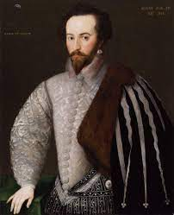
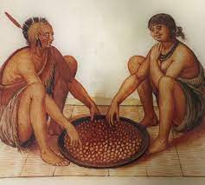
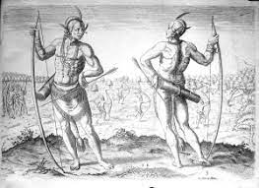
Key Topic 3.4 Raleigh and Virginia
A. The significance of Raleigh and the attempted colonisation of Virginia.
Investigating and promoting the Virginia project
Raleigh sent a fact-finding expedition to Virginia in 1584. The explorers who went were able to barter tin utensils and metal knives (Native American knives were wooden) for game, fish, nuts and a variety of fruits and vegetables. The Indians were very friendly and welcoming tot the English. The accounts brought back to England described this part of Norther America as a paradise.
Raleigh used these findings to persuade a group of English men to leave their homes and make the dangerous voyage across the Atlantic. They were convinced that they would find their fortunes in Virginia. This was important because the first expedition had not been successful and in London, other travellers had spread rumours of fantastical monsters and brutal savages in America.
Manteo and Wanchese
The 1584 expedition also brought two Native American Indians, Manteo and Wanchese, back to England. They were very useful. Thomas Harriot, a mathematician, learned their language (Algonquian), and taught them English. He was then able to make an English-Algonquian ‘dictionary’. Manteo and Wanchese also helped the first English colonists to establish contact with their people.
Raising funds
The cost of colonisation project was enormous – there was not enough money to successfully colonise in the New World by just trading on the voyage. However, there were clear economic benefits to be had that made the voyage worthwhile.
Native Americans would barter things for simple, cheap English goods like woollen cloth.
The colony would provide work for English cloth makers and merchants.
The colony could provide exotic materials such as gold and tobacco that could be brought back to England.
Because of these gains, there would be plenty of revenues for the English government.
Raleigh hoped that the government would fund the new colony. The queen refused. Elizabeth was notoriously careful with money, and had other financial concerns at the time, such as the threat from Spain. She did, however, suggest that the land colonised be called Virginia in her honour. She also gave him a ship and gunpowder worth £400. Raleigh was one of Elizabeth I’s favourites, and this royal backing gave the project prestige. It helped to encourage others to invest, especially courtiers like Sir Francis Walsingham.

Slide 49
Key Topic 3.4 Raleigh and Virginia
A. The significance of Raleigh and the attempted colonisation of Virginia.
Raleigh promised investors that he would take and Spanish ships that he came across, including their cargoes. This was important in encouraging merchants to invest. They had already seen how much Drake had brought back from the Americas in 1580.
Raleigh also invested a lot of his own money in the venture. This was important if others were to believe that it could work. By 1585, he had the resources he needed.
TASK: Answer the following questions.
1. What year did Sir Humfrey Gilbert set sail for North America?
2. What happened that made any attempt to explore North America hard?
3. Why did Raleigh not lead the colonists himself?
4. Even though Raleigh did not lead the colonists, what was he still important?
5. On the fact-finding expedition to Virginia in 1584, what did explorers use to barter with and what did they get in return?
6. Who were Manteo and Wanchese?
7. What were the clear economic benefits to be had that made the voyage worthwhile?
8. Why was it important that Raleigh invested his own money into the venture?
HOT: Unscramble the following sentence and correct the punctuation.
raleigh / royal / I’s / the / prestige / of / project / elizabeth / this / favourites / backing / and / one / gave / was
________________________________________________________________________________________________________________________________

Slide 50
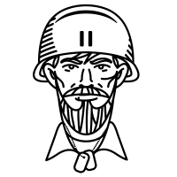







Key Topic 3.4 Raleigh and Virginia
A. The significance of Raleigh and the attempted colonisation of Virginia.
Raleigh's organisations and planning to prepare for the voyage to Virginia.
Who?
Hopefully about 300 colonists (must have a variety of skills)
Landowners, farmers and artisans (e.g., blacksmiths, carpenters, bottle makers, stone-masons weavers, tanners, cobblers)
Hunters (and hinting dogs) and fishermen)
Clergy
Soldiers to protect the other colonists
Make sure there are enough farmers to feed the artisans, clergy and others.
Supplies?
Enough food to get across the Atlantic and last until harvest.
Fresh water for the voyage
Tools and raw materials for the artisans
Farming implements
Seeds for planting
Weapons
Salt and preserving foods
When to sail?
Must sail in enough time for sowing crops (good harvest essential to see the colonists through the winter)
But they can’t go without enough colonists of the right kind.
Ships?
Sufficient ships that are big enough to carry colonists and supplies.
Well armed, in case of attack by Spanish or pirates.
Other Considerations
Spain controls the Caribbean and Florida, so colonists could be attacked
Will need to buy animals in the Caribbean, for eating and breeding
Building shelter – including a fort – when they have arrived
Variety of seeds and in huge quantities (until enough can be grown for some more to be used as seed)
Colonists will need to barter with Indians when they first arrive
The Queen says I can’t go: who will lead the voyage and the colony?
Will need to raise a lot of money!

Slide 51
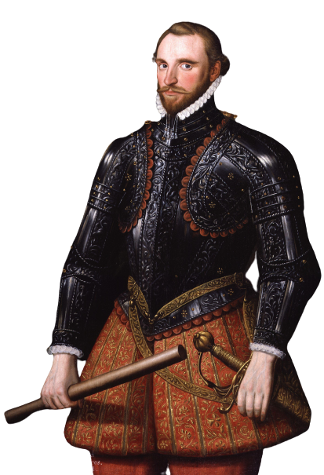
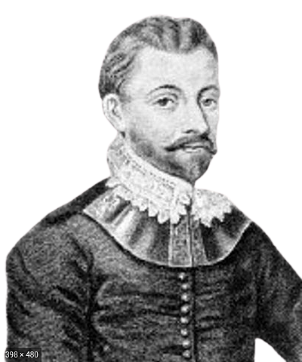
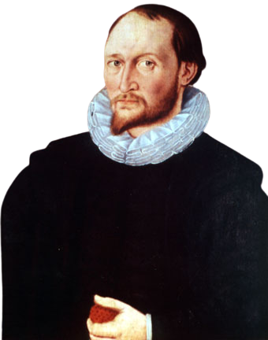
Key Topic 3.4 Raleigh and Virginia
A. The significance of Raleigh and the attempted colonisation of Virginia.
Organising the Virginia project
Finding colonists and sailors
Finding colonists and sailors willing to cross the Atlantic was difficult. In the end, Raleigh’s colony had only 107 colonists, rather than the 300 he had hoped. They were all men. Almost half were soldiers, but there were landowners, farmers, skilled craftsmen (artisans) and a mathematician. Many were attracted by the promise of making their fortune in Virginia.
Who
Role
Suitability
Richard Grenville
Expedition commander
Grenville was a very experienced sailor and soldier; adventurous and hot headed. He did not get on with Ralph Lane, governor of Virginia. He was known to be feared rather than loved.
Ralph Lane
Governor of Virginia
Lane was an expert on fort building. He was also an explorer and a battle-hardened soldier who could rise to a challenge. He enjoyed hardship and pitting his wits against nature with his ‘can do’ attitude.
Thomas Harriot
Translator and cartographer
Harriot had worked with Manteo and Wanchese, the Native Americans brought to England in 1584 to learn Algonquin, with whom he formed a strong bond. He understood navigation and was skilled at making maps.

Slide 52
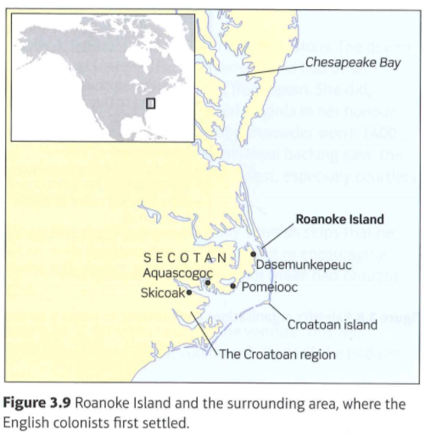
Key Topic 3.4 Raleigh and Virginia
A. The significance of Raleigh and the attempted colonisation of Virginia.
TASK: Look at the table showing the leaders of the expedition, explain in the boxes why they were a good fit to lead the voyage.
Richard Grenville
Ralph Lane
Thomas Harriot
Ships and timing
Raleigh sent five ships to Virginia: Tiger Roebuck, Lion, Dorothy and Elizabeth. The Tiger was the largest and carried all the perishables – meats, vegetables, beer, wine, seeds and grain for bread. The ships left England on 9th April 1585. With a journey of several weeks ahead of them, this was already too late for planting some of their crops needed to see them through the winter.
The English landed on Roanoke Island in late 1585. This, and the surrounding areas, was where the English colonists first settled.

Slide 53
Key Topic 3.4 Raleigh and Virginia
A. The significance of Raleigh and the attempted colonisation of Virginia.
Why was the colonisation of Virginia significant?
Undermining Spain
One of the main reasons why the colonisation of Virginia at this time was significant was because it provided England with a base from which to attack Spanish colonies in the New World. Virginia was ideally placed – not too far from Florida and the Caribbean for attacks to be launched, but far enough away to be reasonably safe from the Spanish.
So, the early colonisation of North America was part of England’s conflict with Spain, but not just for the short term. In the longer term, England hoped to rival Spain’s overseas empire and undermined its influence in the New World. A successful colony in Virginia would serve as an example for other ventures. It would also offer the Native Americans an alternative to Spanish domination: they could choose to turn to English settlers for trade instead, or to help them against the Spanish.
The roots of the British Empire
In the next century, the English did indeed succeed in establishing a strong presence in North America. Although these early attempts to settle in Virginia failed,they did provide an opportunity to learn from the mistakes they made. The roots of the British Empire that developed in the 18th and 19th centuries can be found in these 16th century experiments on settling in new and foreign lands.
Economic Benefits
Trade was vital to the English economy. Elizabeth, I had hoped to encourage English merchants to find new markets as the conflict with Spain made trading in Europe increasingly difficult. Relying on the Netherlands as England’s main market and trade route was far too risky by the 1560s.
Many of the things that were supplied from southern Europe and the Mediterranean could be provided from Virginia. If England could control it, it would not be dependent upon countries like Spain, the Italian states and France for fruit, vines, spices and other luxuries. Tobacco is probably the most famous new crop and trade opportunity brought to England. It was popularised at court by Walter Raleigh. Sugar cane was another valuable crop to come from this part of America.
TASK: If this is the answer, what is the question?
A base to attack Spanish colonies: _______________________________________________________________________________________
Rival Spain’s overseas empire: ___________________________________________________________________________________________
English merchants to find new markets: _______________________________________________________________________________
Far too risky: _______________________________________________________________________________________________________________
Tobacco: _____________________________________________________________________________________________________________________

Slide 54
Key Topic 3.4 Raleigh and Virginia
A. The significance of Raleigh and the attempted colonisation of Virginia.
TASK: Because, But and so. Look at the sentence stem below, turn each one into a complex sentence.
The colonisation of Virginia was significant because _____________________________________________________________________
________________________________________________________________________________________________________________________________
The colonisation of Virginia was significant, but __________________________________________________________________________
________________________________________________________________________________________________________________________________
The colonisation of Virginia was significant, so ___________________________________________________________________________
________________________________________________________________________________________________________________________________
TASK: Why was the colonisation of Virginia significant? In your own words, answer this question using the sentence fragments below. You can use them at the beginning, middle or end of the sentence and you must underline/or highlight the fragments when you used them.
…furthermore… | …although | …the British Empire…
…a successful colony would… | …economically beneficial… | …undermining the Spanish…
________________________________________________________________________________________________________________________________________________________________________________________________________________________________________________________________________________________________________________________________________________________________________________________________________________________________________________________________________________________________________________________________________________________________________________________________________________________________________________________________________________________________________________________________________________________________________________________________
________________________________________________________________________________________________________________________________________________________________________________________________________________________________________________________________________________________________________________________________________________________________________________________________
________________________________________________________________________________________________________________________________________________________________________________________________________________________________________________________________________________________________________________________________________________________________________________________________
________________________________________________________________________________________________________________________________________________________________________________________________________________________________________________________________________________________________________________________________________________________________________________________________
________________________________________________________________________________________________________________________________________________________________________________________________________________________________________________________________

Slide 55
Key Topic 3.4 Raleigh and Virginia
B. Reasons for the failure of Virginia
Why did the attempts to colonise Virginia fail?
There were two attempts at colonising Virginia at this time. Both failed. The fate of the 1587-90 colonisation is still a mystery, but the first colony failed for a number of reasons.
TASK: Answer the questions to the side of each paragraph.
The Voyage
On the first voyage in Virginia, the colonists left England too late to each Virginia in time to plant crops. Also, before the colonists arrived, many were ill. The climate was hot, humid and mosquitoes were everywhere. Because of this, the food rotted quickly.
Disaster struck when the Tiger became damaged. A breach in the hull let in sweater that ruined the food it was carrying including seeds for planting. The dried peas and beans were rescued and were edible, but they couldn’t be planted. In any case, they had arrived too late to plant their own crops. Any hope of establishing a self-sufficient colony had been lost. The colonists were now dependent upon the Native Americans for food.
Colonists: expectations and reality
The colonists soon realised that the idyllic descriptions and reports of Virginia they had been given in England were far from the reality. Many merchants had come in the hope of getting rich quickly rather than being prepared to put in the necessary groundwork for establishing a working colony. They had hoped to find precious metals, but there were none. Being face with the prospect of foraging for nuts and berries when the winter came was not what these men had signed up for.
Why was leaving England late a problem for the colonists?
What happened to the ship Tiger?
How did this contribute to the failure of the expedition?
What were the colonists expectations?
What was the reality?

Slide 56
Key Topic 3.4 Raleigh and Virginia
B. Reasons for the failure of Virginia
The colonists did not co-operate effectively either. The merchants and ‘gentleman’ amongst them had no intention of doing any physical work. They had expected to use Native Americans as labour, but they soon realised ruling over the native people easily would be impossible. Those colonists who were farmers were not prepared to do the work for upper classes. They had not left England to become labourers, but to work their own land.
The soldiers who had volunteered for the voyage were important when defending the colony and leading expeditions to explore uncharted territory, but they did not have skills to farm the land. They were also ill-disciplined. At least one soldier was executed, and his body left rotting as a warning to others.
The colonists had a good skills base between them, but this added to the problems. There were too many craftsmen and not the enough farmers. Many artisans, for example bakers, weavers and brewers, did not have the necessary raw materials. There also wasn’t stone for the stonemasons, which meant that a planned fort could not be built as planned. Instead, it was built using wood.
The hunters and also faced problems. Most of the gunpowder was spoiled when the Tiger damaged is hull and so shooting game like pigeon and deer was very difficult. English fishing techniques did not work in the shallow waters around Roanoke Island.
Why did the colonist not co-operate?
Why did the farmers not want to work for the upper classes?
What was the weaknesses of the soldiers?
List the problems the colonists had with their skills.
How did the hunters face problems?

Slide 57
Key Topic 3.4 Raleigh and Virginia
B. Reasons for the failure of Virginia
Inexperience
Overall, therefore, the colonists were very reliant on the Native Americans for their survival. To some extent, the expedition’s problems stemmed from it being the first ever undertaking of its kind by the English. Although Raleigh clearly tried to think of everything necessary for a thriving colony, there were not the right kinds of people in the right numbers. Before a colony thrives, it has to be established, and that is tough. Many were not cut out for a life of hardship and long-term rewards.
How did inexperience lead to the failure?
TASK: Gap fill. Complete the gap fill below.
Native American Resistance
The _______________ were lucky to have Manteo and Wanchese with them to help establish relations with the Algonquian people. However, it was not enough. The local Chief, Wingina, ruled Roanoke Island and a small settlement on the mainland. He was an unpredictable ___________________ and suspicious of the English. He also grew tired of the constant demands for _____________ handouts from the settlers. Although welcoming at first, Wingina turned against the English settlers.
_______________________ believed that the English and supernatural powers from their God that they directed against the Native Americans. Many believed this because the English seemed to have the power to kill them without touching them: it was noticed that after the English left a settlement, many natives would die from strange causes they had never seen before. These were actually _______________ brought form England that the natives had not encountered before,
There were also some violent clashes between the natives and English as the hardships of winter set in and the colonists wanted more handouts. By spring 1586, Wingina asked other chiefs to join with him to _________________ the English. Lane found out about the planned ambush and was prepared. Wingina was killed. What happened next is unknown, as the only document recording the even is Lane’s journal and it has pages ___________________. However, records do show that he decided the colony had reached crisis point. Lane and the remaining colonists left Virginia and arrived back in _____________________ on 27 July 1586.
Wingina | colonists | diseases | attack
food | missing | character | Portsmouth

Slide 58




Key Topic 3.4 Raleigh and Virginia
B. Reasons for the failure of Virginia
The Voyage
Colonists
Why did attempts to colonise Virginia fail
Inexperience
Native American Resistance

Slide 59
Key Topic 3.4 Raleigh and Virginia
B. Reasons for the failure of Virginia
Roanoke 1587-90
Despite the outcome of the first settlement, another attempt at colonising Virginia set out from England in 1587. This time there were 17 women and several families on board. Many colonists came from London’s poverty-stricken alleys. They would be familiar with hardship and willing to work hard for a better life in the New World. Each was guaranteed to be given at least 500 acres of land to farm.
Manteo was made Lord of Roanoke by Walter Raleigh and the artist, John White, was put in overall charge of the expedition. White had already survived the 1585 colonisation and knew what to expect; Manteo might be able to encourage local Indians to co-operate with the English more. However, the Indians were hostile from the start.
John White’s adviser, George Howe, disappeared. He was found dead. He had 16 arrow wounds. Manteo led an attack against the local Roanoke Indians as a retaliation, but it was a mistake: they killed some of the remaining friendly Indians from nearby Croatoan settlements instead.
John White was asked to go back to England to update Raleigh on what had happened. When he returned to Roanoke, three years later in 1590, it was deserted. What happened to the settlement remains a mystery. It is though that hurricanes might have destroyed it, but this does not explain the fate of the colonists. The word Croatoan was found carved on a post. This suggested that they had relocated to the nearby Coratoan settlement. However, no trace of the colonists was ever found.
TASK: Complete the sentence below relating to Roanoke 1587-90
The colonist were more prepared for the second attempt at colonising Virginia because…
Making Manteo Lord of Roanoke was a good idea because…
Attacking the local Roanoke Indians was a mistake because…
On returning to Roanoke, ….

Slide 60
NOTES
________________________________________________________________________________________________________________________________________________________________________________________________________________________________________________________________________________________________________________________________________________________________________________________________________________________________________________________________________________________________________________________________________________________________________________________________________________________________________________________________________________________________________________________________________________________________________________________________
________________________________________________________________________________________________________________________________________________________________________________________________________________________________________________________________________________________________________________________________________________________________________________________________
________________________________________________________________________________________________________________________________________________________________________________________________________________________________________________________________________________________________________________________________________________________________________________________________
________________________________________________________________________________________________________________________________________________________________________________________________________________________________________________________________________________________________________________________________________________________________________________________________
________________________________________________________________________________________________________________________________________________________________________________________________________________________________________________________________________________________________________________________________________________________________________________________________
________________________________________________________________________________________________________________________________________________________________________________________________________________________________________________________________________________________________________________________________________________________________________________________________
________________________________________________________________________________________________________________________________________________________________________________________________________________________________________________________________________________________________________________________________________________________________________________________________
________________________________________________________________________________________________________________________________________________________________________________________________________________________________________________________________________________________________________________________________________________________________________________________________
________________________________________________________________________________________________________________________________________________________________________________________________________________________________________________________________________________________________________________________________________________________________________________________________
________________________________________________________________________________________________________________________________________________________________________________________________________________________________________________________________________________________________________________________________________________________________________________________________
________________________________________________________________________________________________________________________________________________________________________________________________________________________________________________________________________________________________________________________________________________________________________________________________

Slide 61
NOTES
________________________________________________________________________________________________________________________________________________________________________________________________________________________________________________________________________________________________________________________________________________________________________________________________________________________________________________________________________________________________________________________________________________________________________________________________________________________________________________________________________________________________________________________________________________________________________________________________
________________________________________________________________________________________________________________________________________________________________________________________________________________________________________________________________________________________________________________________________________________________________________________________________
________________________________________________________________________________________________________________________________________________________________________________________________________________________________________________________________________________________________________________________________________________________________________________________________
________________________________________________________________________________________________________________________________________________________________________________________________________________________________________________________________________________________________________________________________________________________________________________________________
________________________________________________________________________________________________________________________________________________________________________________________________________________________________________________________________________________________________________________________________________________________________________________________________
________________________________________________________________________________________________________________________________________________________________________________________________________________________________________________________________________________________________________________________________________________________________________________________________
________________________________________________________________________________________________________________________________________________________________________________________________________________________________________________________________________________________________________________________________________________________________________________________________
________________________________________________________________________________________________________________________________________________________________________________________________________________________________________________________________________________________________________________________________________________________________________________________________
________________________________________________________________________________________________________________________________________________________________________________________________________________________________________________________________________________________________________________________________________________________________________________________________
________________________________________________________________________________________________________________________________________________________________________________________________________________________________________________________________________________________________________________________________________________________________________________________________
________________________________________________________________________________________________________________________________________________________________________________________________________________________________________________________________________________________________________________________________________________________________________________________________

